Slide 1
Improving Your Formulary and Denials Management
Zinkeng Asonganyi, PharmD
Director of Pharmacy Services-Ambulatory Operations
University of Texas Medical Branch

Slide 2
Objectives
Understand the data and metrics your cancer program or practice must collect and report on to improve revenue cycle management, eliminate waste, and reduce costs.
Gain insight on how to use these data to drive quality improvement initiatives at your cancer program or practice.
Identify opportunities for financial navigation to support revenue optimization at your cancer program or practice.

Slide 3
Objectives
Assess your denial management process and work with all members of your revenue cycle team to reduce denials.
Review your pre-authorization process and develop strategies to make this process more efficient to better support patients and providers.

Slide 4
Formulary Management
What is formulary management?
Process where drugs are evaluated for their safety, efficacy, and value to prevent unwarranted clinical variation and reduce unnecessary costs.
Major strategy to combat rising drug costs and led by chair/vice chair of the Pharmacy and Therapeutics Committee (P&T)

Slide 5
Formulary Management
Open vs. Closed Formulary
Inpatient setting:
Tends to be closed formulary because of diagnosis-related group reimbursement
Outpatient:
Tends to be open formulary in accordance with guideline recommendations
For example, National Comprehensive Cancer Network (NCCN) Guidelines®, given that pre-approval is required by the payer

Slide 6
Considerations: Formulary Management in Oncology
Oncology:
Between Jan. 2022 and April 6, 2022: 9 U.S. Food and Drug Administration (FDA) approvals
Approval of the drug with restrictions to hematology/oncology service line
Cost/reimbursement is an important consideration during drug formulary review, especially when comparing to another comparable agent

Slide 7
Considerations: Formulary Management in Oncology
Oncology:
Site of care considerations: Hospital outpatient department vs. physician clinic vs. home infusion vs. pharmacy benefits
Drug shortages

Slide 8
Biosimilar Agents and Considerations
FDA definition:¹
“A biosimilar product is a biological product that is approved based on a showing that it is highly similar to an FDA-approved biological product, known as a reference product, and has no clinically meaningful differences in terms of safety and effectiveness from the reference product.”

Slide 9
Biosimilar Agents and Considerations
FDA definition:¹
“An interchangeable biological product…meets additional standards for interchangeability” and “may be substituted for the reference product by a pharmacist without the intervention of the healthcare provider who prescribed the reference product.”

Slide 10
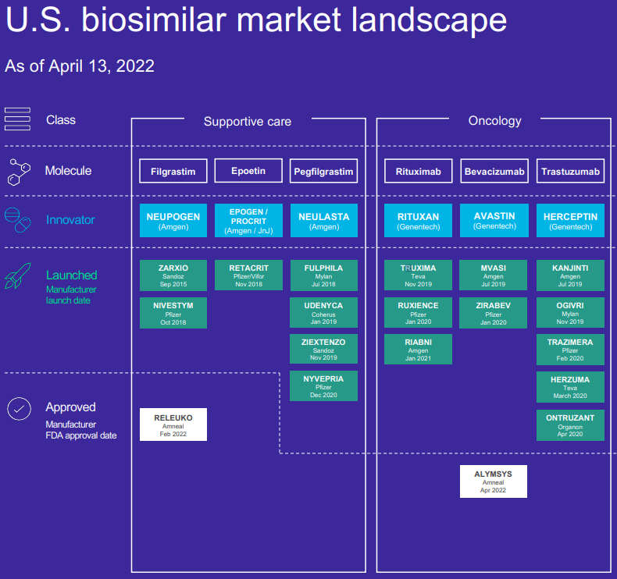
2

Slide 11
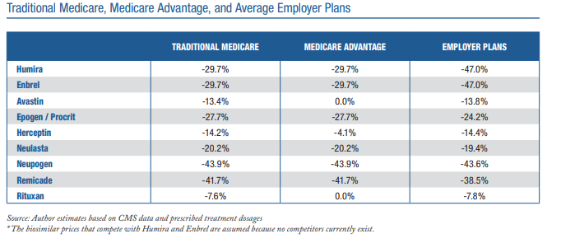
Biosimilars
Forecasted to deliver over $133 billion in aggregate savings by 2025.
Total savings to patients’ out-of-pocket costs are estimated to reach up to $238 million.
3
Notes:
According to

Slide 12
Barriers to Biosimilar Adoption
Reference drug manufacturers protecting market share by creating new formulations or giving deep discounts to payers and pharmacy benefit managers (PBMs) to maintain formulary preference
Resistance from certain providers
Payer formulary inclusion→ Inventory management complexities
Regulatory issues and interchangeability
Information technology (IT) support

Slide 13
Formulary Strategy for Biosimilars
Evaluate purchase price of each biosimilar agent and compare
Evaluate payer mix and payer preferred biosimilar for each reference drug
Any manufacturer patient assistance programs?
Margin analysis
Establish biosimilar interchange policy to allow for auto substitution by pharmacists

Slide 14
It’s More Than Just Cost Savings
How is your organization being reimbursed for these expensive medications?
How are you ensuring that clean claims get out to the payers in a timely fashion?
It’s better to be right the first time, instead of chasing denials.

Slide 15
Payment for Drugs: Outpatient Infusion and Service
Fee schedule:
Medicare’s Hospital Outpatient Prospective Payment System (HOPPS)
Medicaid
Fee-for-Service
Percentage of charges
Capitated model: Global budget revenue
Flat payment

Slide 16
Payment for Drugs: Outpatient Infusion and Service
Benefits Investigation
Prior Authorization
Local Coverage Determination
Medical Necessity
National Drug Code Coverage

Slide 17
Payment for Drugs: Outpatient Infusion and Service
Benefits investigation:
Verifying patients' insurance, type of coverage, and any out-of-pocket amount due
Prior authorization:
Formulary management strategy by payer to ensure appropriate drug use (medical necessity)

Slide 18
Payment for Drugs: Outpatient Infusion and Service
Medicare process for pre-certification:
No prior authorization required
List of drugs approved per ICD-10 code
Local coverage determination (LCD): Administered by local Medicare administrative contractor (MAC)
If drug is not on LCD, it is NOT approved
If drug is on LCD and given according to approved guidelines, it is approved

Slide 19
Prior Authorization
Who owns the prior authorization process at your cancer program or practice?
Critical process to ensure revenue integrity
Needs to be coordinated: complex and time consuming
One of the top reasons for claim denials
Use your electronic health record (EHR)!

Slide 20
Prior Authorization
Allow appropriate time for completion, for example, provider sends order 7 days in advance
DO NOT schedule patient if prior authorization is not approved
Monitor and track expiration (e.g., reports in your EHR)

Slide 21
Payment for Drugs and Biologicals
4

Slide 22
Status Indicators
Status Indicator | Description | Paid Under HOPPS | Payment
G | Pass-through drugs and biologicals | Yes | Separate ambulatory payment classification (APC)
K | Non-pass-through drugs and biologicals | Yes | Separate APC
N | Services packaged into APC rates | Yes | No separate APC
L | Influenza and pneumococcal vaccine | No | Paid at reasonable cost
M | Services not billable to MAC | No | X
E2 | Services in which pricing information and claims data are not available | No | Not paid by Medicare when submitted on outpatient claim
A | Services furnished that are paid under a fee schedule | No | Paid by MAC’s under fee schedule
5

Slide 23
Pass-Through Status: Biosimilars

Slide 24
Denials
Buy and Bill: A claim is sent out to the payer and payment is denied
Could be due to several reasons:
No prior authorization obtained
Medical necessity: LCD, national coverage determination (NCD)
Additional documentation required
Coding error
Missing claim information
Non covered
Drug waste due to smaller vial size present commercially

Slide 25
It’s All About the Details
Remittance advice:
Electronic data interchange that contains insurance payment explanations
Includes: Claim payment information, denial codes, explanation of denial
835 type files

Slide 26
Combating Denials
Goal is to get a clean claim out the first time
Timely writing and submission of appeal letters with relevant information
Allow time for prior authorization team to obtain authorization.
5-7 days lead time is reasonable.

Slide 27
Combating Denials
Pre-certification built into infusion regimen (therapy plan/treatment plan in EHR)
If an order is signed or a change to regimen occurs, a referral is dropped in a work queue.
Medicare: Have clinical staff (nurse or pharmacist) review LCD/NCD
If no prior authorization is required, clinical staff should review payer medical necessity guidelines
Target denials by volume of reason codes.
Reason code may not represent the actual reason for denial

Slide 28
Combating Denials
Ensure accurate drug build
NDC
Accurate HCPCS (Healthcare Common Procedures Coding System) code and revenue code
Using appropriate unclassified HCPCS code (C9399 vs. J3490)
Comprehensive charge capture
Barcoded medication administration
Dispense prep/dispense prep workflow (in EHR)
Waste billing: Use appropriate vial sizes to generate the least waste

Slide 29
Medical Necessity
Complete prior authorization (PA) and told by payer “No PA required.”
Get a denial after given for medical necessity.
Payer website has medical polices and requirement by coverage.

Slide 30
Site of Care
Choice of physical location for infusion administration
Hospital: inpatient/outpatient
Home infusion
Physician office
Free standing infusion suite
Payer might allow patient to receive a few doses in a hospital outpatient infusion center but mandates patient to go to a cheaper site of service for subsequent infusions.
If you don’t keep track of site of care restrictions→ increased denials

Slide 31
Why Is Site of Care So Important?
Payers shifting services to a lower cost of care setting
Expensive specialty medication and biologics
21-Inpatient Hospital
21-Outpatient Hospital Department
11-Office
12-Home
49-Independent Clinic

Slide 32
Medical vs. Pharmacy Benefits
Specialty drugs may be covered under medical and/or pharmacy benefits
Medical benefit:
Buy-and-bill model under medical benefit

Slide 33
Medical vs. Pharmacy Benefits
Pharmacy benefit:
Buy and bill under the pharmacy benefit
Can be self-administered or taken to site of care for administration
White bagging
Brown bagging
Clear bagging

Slide 34
Questions?

Slide 35
References
U.S. Food and Drug Administration. Biosimilar and interchangeable products. Published October 23, 2017. Accessed April 26, 2022. https://www.fda.gov/drugs/biosimilars/biosimilar-and-interchangeable-products
AmerisourceBergen. U.S. biosimilar report. Published April 13, 2022. Accessed May 2, 2022. https://www.amerisourcebergen.com/-/media/assets/amerisourcebergen/biosimilars-page/sgs-biosimilars-usmarketlandscape-041422.pdf?la=en&hash=DC34E27B09855CFD4F85BFE61F878CF2EFA6127B
Winegarden W. Promoting biosimilar competition to reduce patients’ out-of-pocket costs. Published March 2020. Accessed April 2022. https://www.pacificresearch.org/wp-content/uploads/2020/03/BiosimilarReduceOutofPocket_Fweb.pdf
American Society of Health-System Pharmacists. 2021: upheavals in drug payment, drug pricing, and more! Published December 9, 2020. https://www.eventscribe.com/2020/midyear/fsPopup.asp?Mode=presInfo&PresentationID=770129
Centers for Medicare & Medicaid Services. Addendum D1—proposed payment status indicators. Accessed May 2, 2022. https://www.cms.gov/Medicare/Medicare-Fee-for-Service-Payment/HospitalOutpatientPPS/Downloads/CMS1392P_Addendum_D1.pdf

