Slide 1
Cross-Functional Communication to
Improve Revenue Cycle Management
Angie Santiago, CRCS
Manager, Oncology Financial Advocacy
Sidney Kimmel Cancer Center at the Thomas Jefferson University Health System

Slide 2
Agenda
Review the revenue lifecycle, beginning at scheduling and ending with payers’ payment(s).
Build understanding of each step of the revenue-cycle process.

Slide 3
Revenue Lifecycle
Financial Advocate
Phone Room
Front Desk
Authoriza-tion Team
Biller
Accounts Receivable Team

Slide 4
Oops, We Scheduled Wrong
Phone Room
Care Team
Patient with non-participating coverage scheduled
Front Desk
Authorization Team
Office visit and plans treatment/next steps
Checks patient in
Identifies non-participating coverage
Claim
Denied office visit
Financial Advocacy Team
Burden of bad news

Slide 5

Phone Room
Insurance participating guide
Scripts for non-participating coverage options
Email/notification of new appointments

Slide 6
Workflow: Non-Participating Coverage
Phone Room
Patient with non-participating coverage
Financial Advocacy Team
Reviews options:
Script
Referral to financial advocacy team
Identify participating facilities
Identify change of coverage options

Slide 7
Oops, Established Patient with
Change of Coverage
Treatment
Front Desk
Claim
Received
Checks patient in
Updates new coverage
Infusion denied
Or inactive Coverage

Slide 8
Front Desk
Change of Insurance
Future Changes
Real-Time Communication
COBRA
New coverage
Authorization team
Care team
Losing coverage
Inactive coverage
COBRA = Consolidated Omnibus Budget Reconciliation Act

Slide 9
Workflow: Change of Coverage
Front Desk
Updates new coverage or inactive coverage
Notifies in real time
Checks patient in

Slide 10
Workflow: Change of Coverage
Authorization Team:
New Coverage
Preferred drug
Immediate authorization request
Reviews new coverage
Subject matter experts

Slide 11
Workflow: Change of Coverage
Financial Advocacy Team:
Inactive Coverage
Promptly assess coverage options
COBRA
Medical assistance
Affordable Care Act (ACA) plan
Care Team
Notified of potential treatment hold

Slide 12

Tips for the Pharmacy/Care Team
Communication:
  Include financial advocacy/authorization teams on drug validation groups
    New drugs
    New regimens
Department task force

Slide 13
Authorization Team
Treatment
Preferred drug
Medicaid Changes
Coding
Documentation
Fee-for-service to managed care
Mandated drugs
Specialty
Site of service

Slide 14
Treatment
Preferred drug
Specialty drug
Site-of-service drug

Slide 15
Tips for the Authorization Team
Medical benefits check
Insurance provider representatives
Understand payers’ medical policies/guidelines
Drug prior authorization attempt

Slide 16
Oops, We Billed Wrong
Financial Advocate
Incorrect Billing
Accounts Receivable Meeting
Patient assistance program
Authorization denial/adjustment
Paid Claims
Rebilled claims
Field reimbursement manager
340B pharmacy acquisition cost: $275,088
Payments: $411,000

Slide 17
Biller
Communication of new drugs
J-9999 vs. C-9399
Claim documentation
Monthly meetings

Slide 18
Accounts Receivable Team
System Adjustments
Denials
Review of Authorized Documentation
Bundled Payments
Notes:
Contractual Allowed Amount Build
Adjustment Report
Trends for referral/authorization
Inconsistent Diagnosis
Payer Escalation
Authorized Diagnosis Denied

Slide 19
System Adjustments/Bundled Payments
Contractual write-offs are those wherein the excess of the billed amount over the carrier's allowed amount is written off.
System Adjustments
  Request accounts receivable team to provide adjustments
Bundled payments
  Ensure revenue integrity has correct build

Slide 20
Denials/Review of Authorized Documentation
Group effort
Monthly reviews:
  Identify trends
Timely communication

Slide 21
Denials/Review of Authorized Documentation
Documentation:
  Authorization attachment
  “No authorization required” attachment
  National Comprehensive Cancer Network Guidelines®
  Reference number

Slide 22
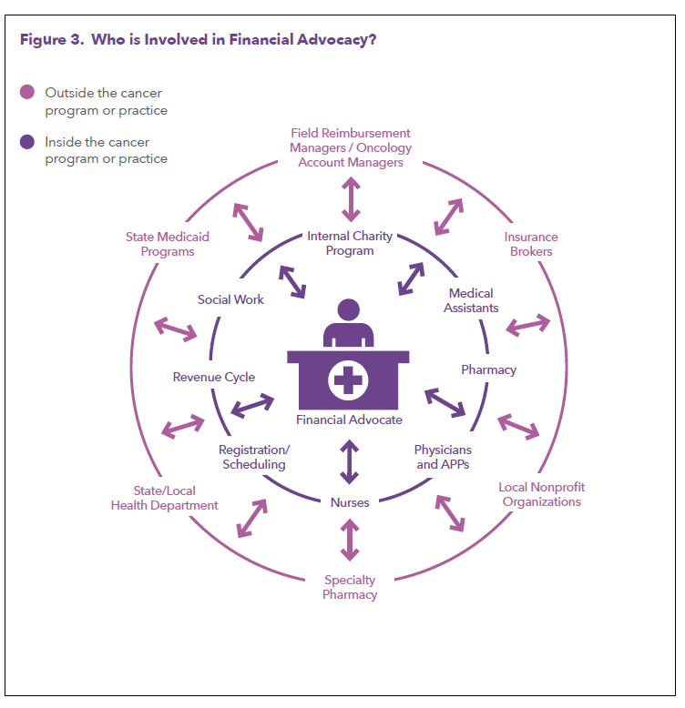
1

Slide 23
Questions?
Angie Santiago, CRCS
Manager, Oncology Financial Advocacy
Phone: 215.503.5213
Angie.Santiago@Jefferson.Edu

Slide 24
References
Association of Community Cancer Centers, ACCC Financial Advocacy Network. Ready, set, go! Financial advocacy playbook. Published September 2021. Accessed April 27, 2022. https://www.accc-cancer.org/home/learn/financial-advocacy/financial-advocacy-playbook

