Slide 1
Calculating and Communicating Treatment Costs to Patients
Wendi Waugh, RT (R)(T), CMD, CTR
Administrative Director of Cancer Services & Community Health and Wellness
Southern Ohio Medical Center, SOMC Cancer Center

Slide 2
Southern Ohio Medical Center (SOMC)
234-bed nonprofit healthcare organization located in Portsmouth, Ohio
Employs approximately 3,000 employees and 240 providers
Named one of Fortune’s “100 Best Companies to Work For” for 15 consecutive years.
One of Ohio’s top employers since 2010

Slide 3
SOMC Cancer Services
Dedicated outpatient facility housing for medical oncology, hematology, breast oncology, high risk, and radiation oncology clinics
We provide outpatient infusion, radiation therapy, laboratory, pharmacy, social work, financial counseling, genetic counseling, palliative care, clinical trials and women’s imaging
Oncology Care Model participant

Slide 4
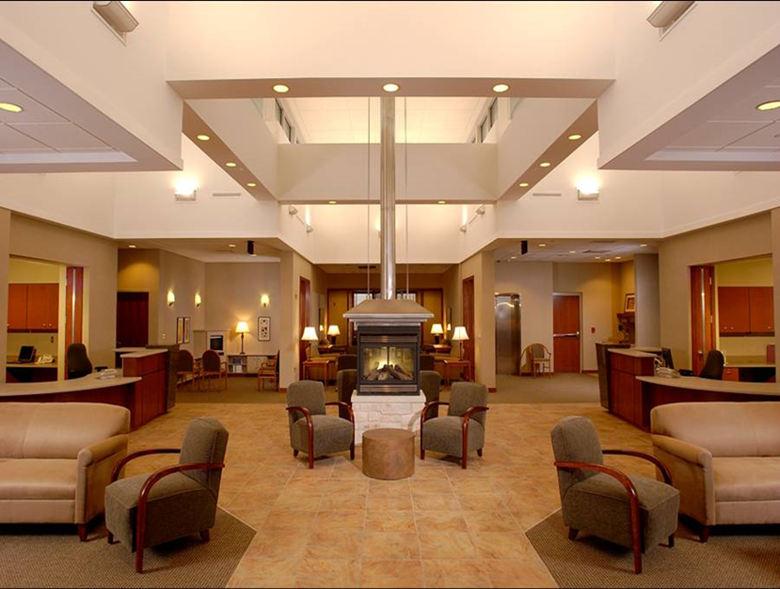
SOMC Cancer Services
Accredited by:
American College of Radiology (2007)
American College of Surgeons (2008)
National Accreditation Program for Breast Centers (2017)

Slide 5
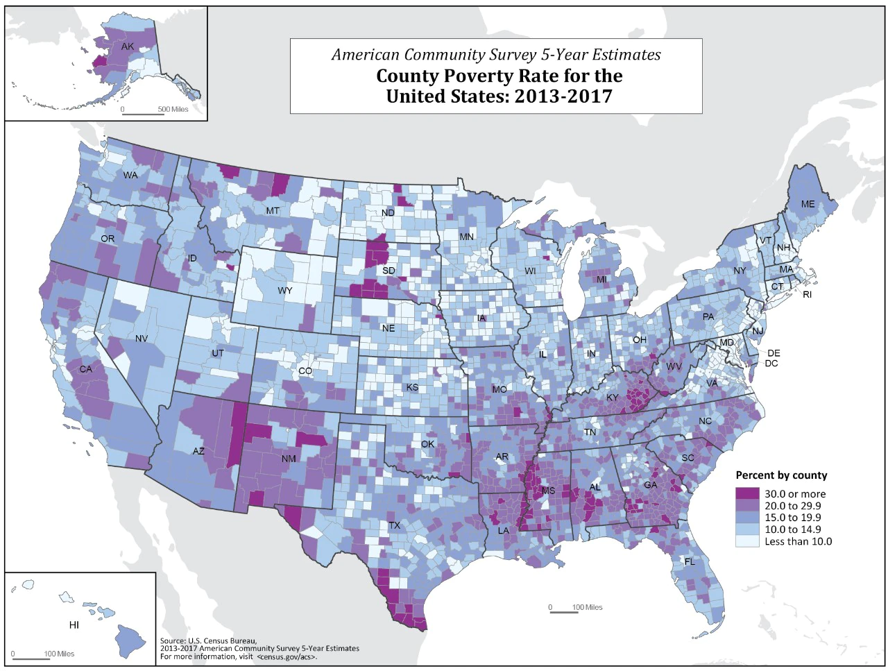
SOMC Demographics
2
Scioto County, Ohio:¹
Median age = 40 years old
23% below poverty
22% with private insurance
44% with Medicare
28% with Medicaid
6% without insurance
85% are high-school graduates

Slide 6
Oncology Care Model (OCM)³
Participation period: July 1, 2016 - December 31, 2021
Goal: Achieve better health, improved care, and smarter spending by introducing aligned incentives to encourage practice redesign
Medical oncology sites applied and were accepted into the program

Slide 7
OCM³
Participation requirements:
24/7 clinician availability with real-time electronic health record (EHR) access
Certified EHR technology
Use of data for continuous quality improvement
Patient navigation
Individualized care plans with 13 National Academy of Medicine (formerly the Institute of Medicine) components
Therapies compliant with nationally recognized guidelines
Regularly report discreet data elements

Slide 8
OCM: 13 IOM Components³
Patient information
Diagnosis
Prognosis
Treatment goals
Treatment plan and duration
Expected response to treatment
Treatment benefit/harm
Quality of life
Care responsibility team
Advance care planning
Estimating out-of-pocket costs
Psychosocial screen and plan
Survivorship plan

Slide 9
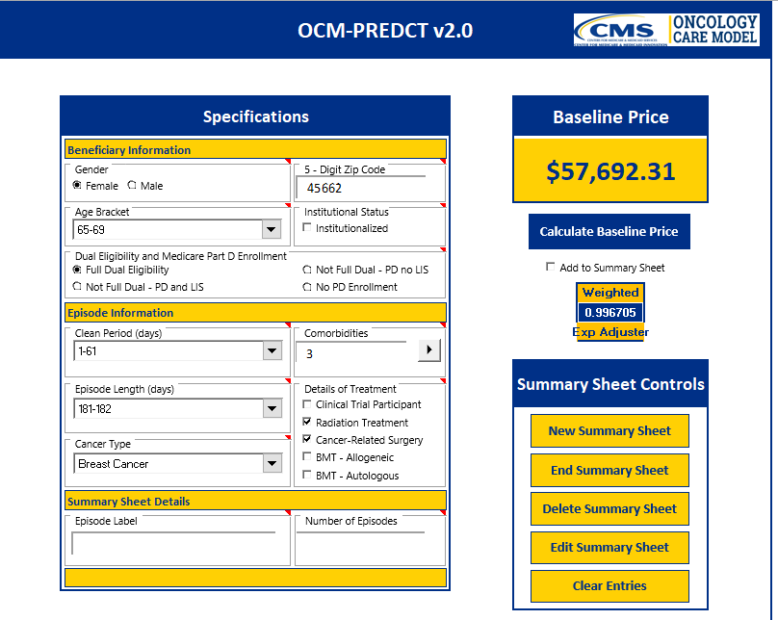
The PREDCT Tool
4
OCM supplied a tool—the PREDCT Tool—to assist with estimating costs
Utilizes a practice’s historical charge history to predict out-of-pocket costs for patients
Microsoft Excel platform

Slide 10
The PREDCT Tool
4
Export and design a digestible patient format
We found the process to be clunky, time consuming, and largely inaccurate, especially in sites through which new drug modalities were incomparable to previous history

Slide 11
The SOMC Way
Developed a form for patients
Financial advocate met with patient to review form and answer questions
Social Worker met with patient to identify barriers to treatment—barrier assessment included financial concerns, transportation, psychosocial, housing and food insecurities
Compassion fund recommendations when applicable

Slide 12
The SOMC Way
No co-pay assistance or patient assistance program support was provided
H-CAPS (Hospital Consumer Assessment of Healthcare Providers and Systems) discounts were available

Slide 13
Along Came the ACCC Financial Advocacy Network
5
Through networking and happenstance, I got involved in the Network
At first, it was like drinking from a fire hose
As an administrator, I had enough knowledge to know what I wanted but had no idea how to get it

Slide 14
Workforce Taskforce Learning
5
Evaluate stacks and processes within the stacks for gaps, hand off drops or error-prone processes
Unsupported stacks fail the patient-organizational partnership

Slide 15
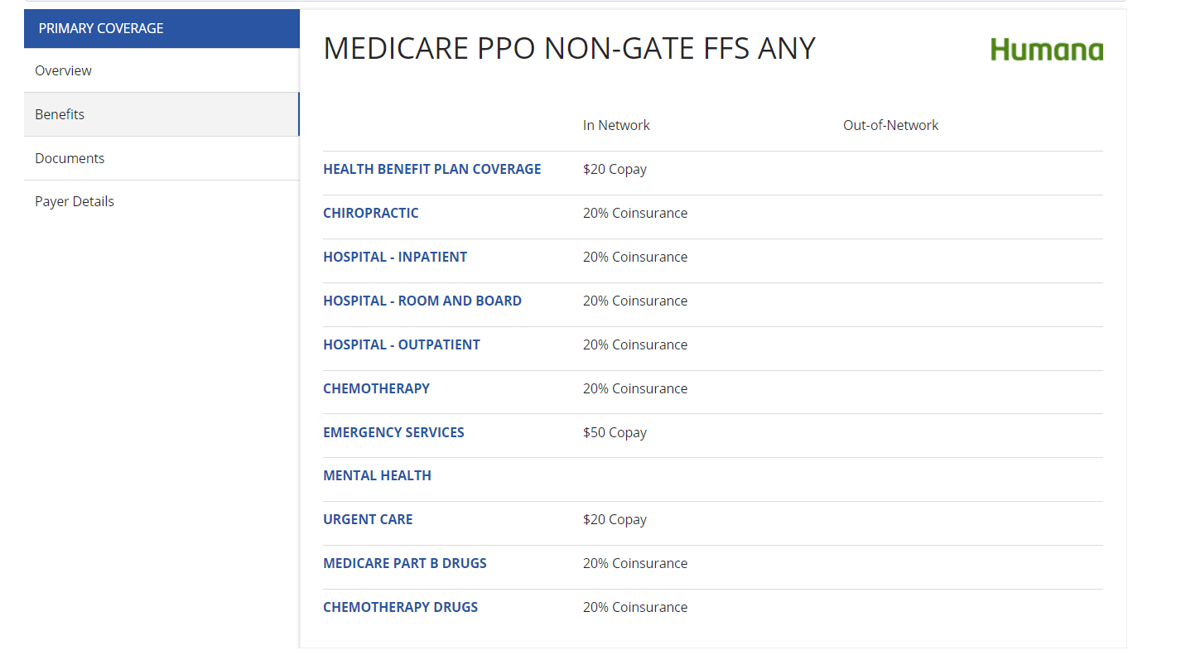
TailorMed Capabilities
6

Slide 16
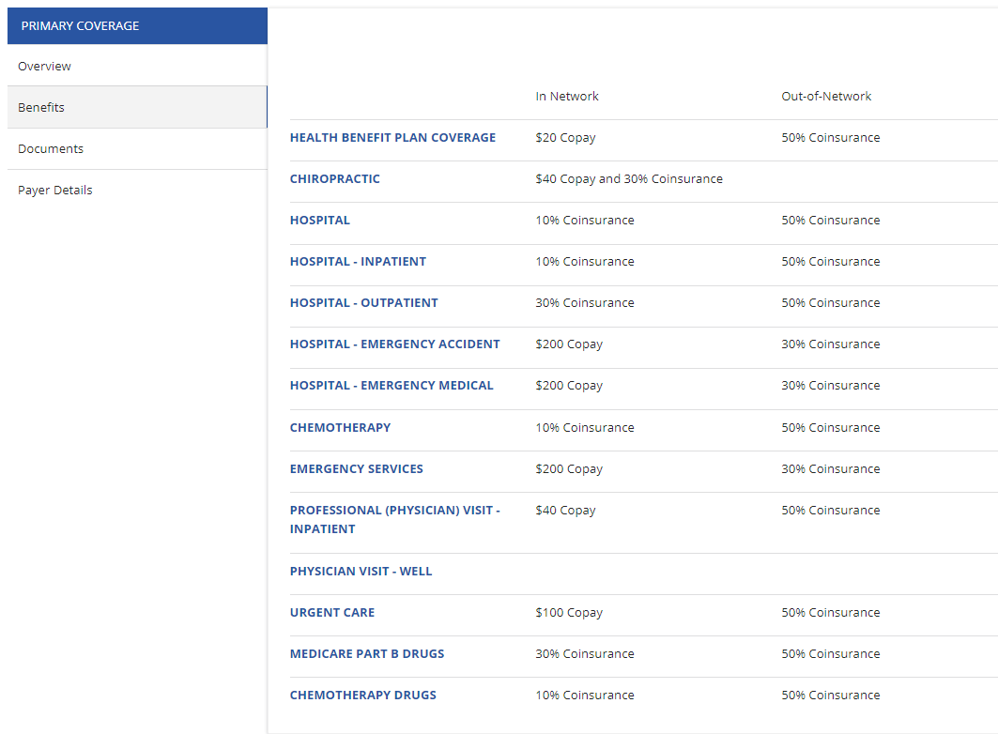
TailorMed Capabilities
6

Slide 17
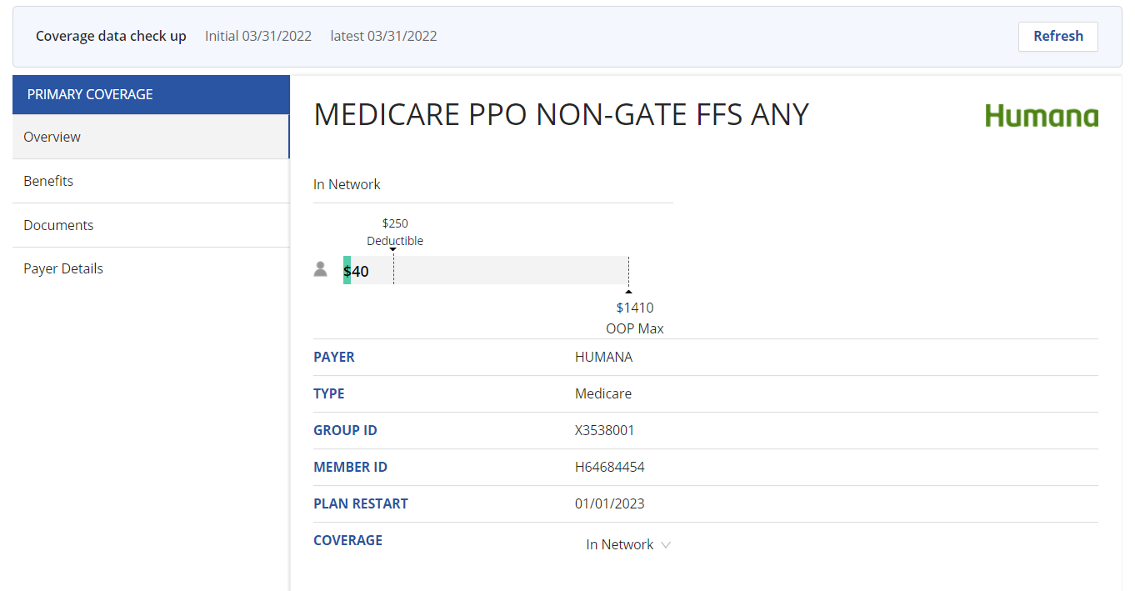
TailorMed Capabilities
6

Slide 18
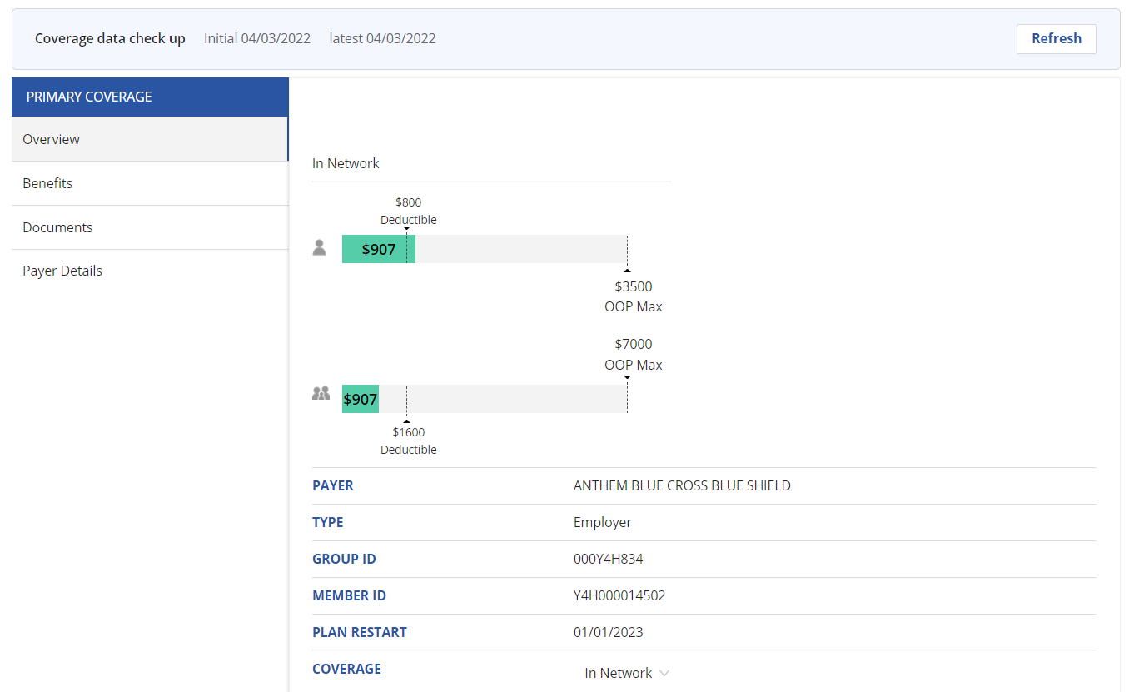
TailorMed Capabilities
6

Slide 19
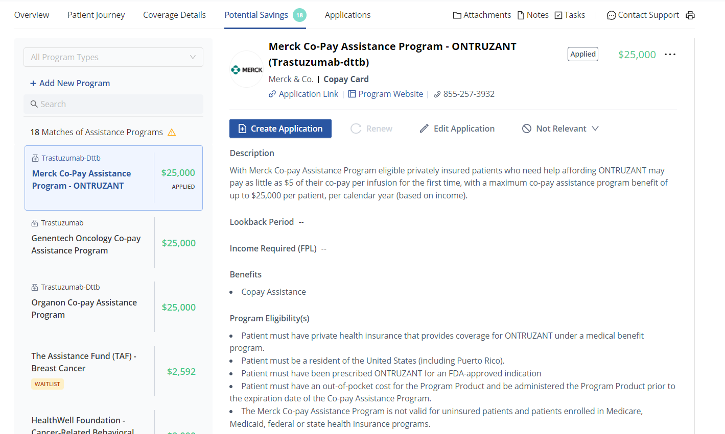
TailorMed Capabilities
6

Slide 20
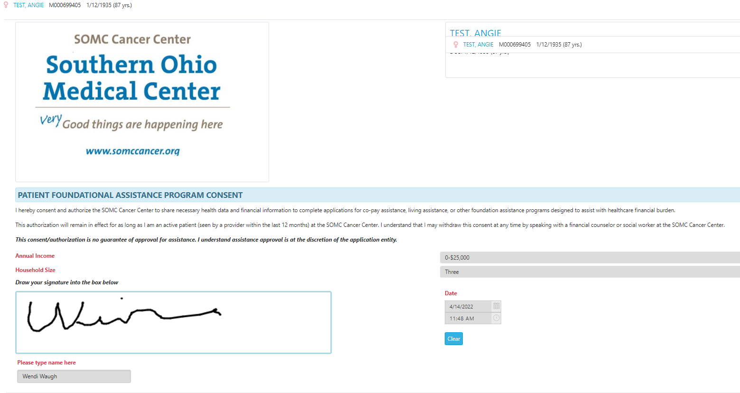
TailorMed Requirements
Dedicated staff
Extensive training
Development has been quick but needs ongoing refinement
Reporting is in early stages
Need family size and household income
Other resources

Slide 21
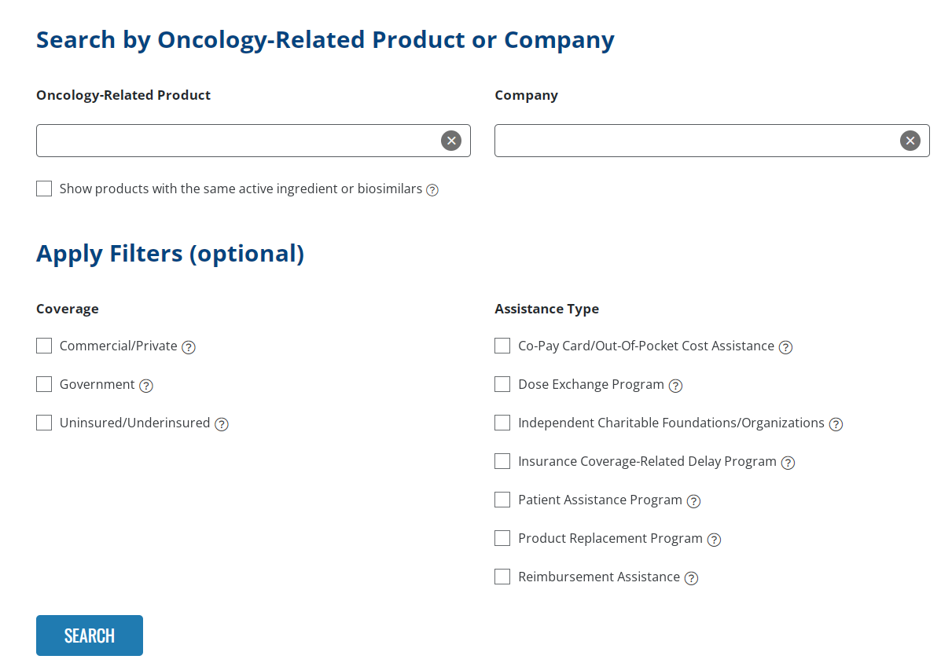
Out-of-Pocket Assistance: ACCC Patient Assistance & Reimbursement Guide
7

Slide 22
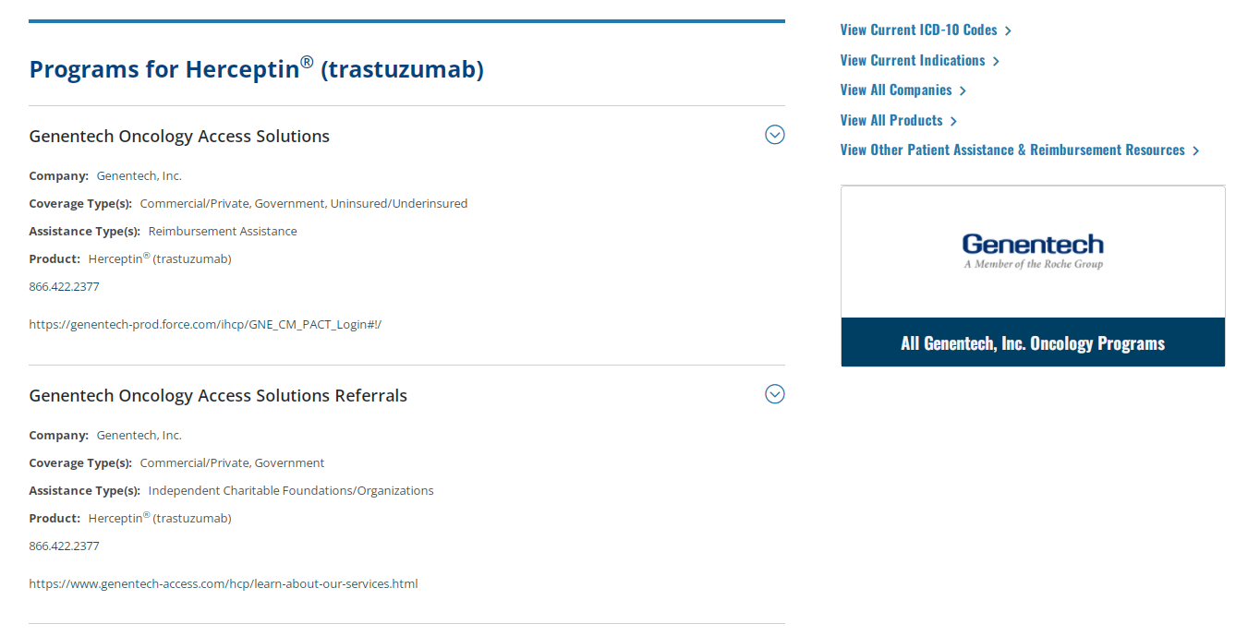
Out-of-Pocket Assistance: ACCC Patient Assistance & Reimbursement Guide
7

Slide 23
SOMC (A Better Way) Improvement Project 2020, 2021, and Beyond
Things happen along the journey:
COVID-19 (March 2020) resulted in working to explore other methods of delivering out-of-pocket cost and social work screens
EHR transition to Meditech Expanse (August 2020)
TailorMed purchase and configuration (November-December 2020)
Staff training for TailorMed (January-March 2021)

Slide 24
SOMC (A Better Way) Improvement Project 2020, 2021, and Beyond
Things happen along the journey:
Acquisition of ambulatory infusion clinic (March 2021)
Staff turnover #1 (May 2021)
Staff turnover #2 (January 2022)
Staff training for TailorMed (April 2022)
Staff expectations (May 2022)

Slide 25
Excited About the Future
Growing the Network and continuing conversations
Exploring benchmarks, job descriptions, and roles
Advocating for certification and career advancement
Eliminating patient barriers to accessing affordable medical care

Slide 26
Questions and Discussion
Wendi Waugh
740.356.7557
waughw@somc.org
Safety | Quality | Service | Teamwork | Performance

Slide 27
References
University of Wisconsin Population Health Institute. 2022 county health rankings. Accessed April 27, 2022. http://www.countyhealthrankings.org/app/ohio/2017/measure/factors/9/map
United States Census Bureau. County poverty rate for the United States: 2013-2017. Published December 6, 2018. Accessed April 27, 2022. https://www.census.gov/library/visualizations/2018/comm/acs-5yr-poverty-all-counties.html
Centers for Medicare & Medicaid Services. Oncology care model. Published March 8, 2022. Accessed April 27, 2022. https://innovation.cms.gov/innovation-models/oncology-care
Southern Ohio Medical Center. Oncology care model data via the PREDCT tool. Accessed April 16, 2022.
Association of Community Cancer Centers, ACCC Financial Advocacy Network. Ready, set, go! Financial advocacy playbook. Published September 2021. Accessed April 27, 2022. https://www.accc-cancer.org/home/learn/financial-advocacy/financial-advocacy-playbook
TailorMed. Screenshots from Southern Ohio Medical Center’s TailorMed platform. Accessed April 16, 2022. https://tailormed.co/
Association of Community Cancer Centers. Patient assistance & reimbursement guide. Accessed April 16, 2022. https://www.accc-cancer.org/home/learn/publications/patient-assistance-and-reimbursement-guide/patient-assistance-guide

