Slide 1
Immunotherapy in Non-Small Cell Lung Cancer (NSCLC)
Renato G. Martins, MD, MPH
Medical Director, Thoracic/Head and Neck; General Oncology and Hematology
Seattle Cancer Care Alliance
July 28, 2015 11:30 am – 12:30 pm, EST
ICLIO e-Course 02

Slide 2
Objectives
By the end of this e-course, participants will be able to:
Understand the current treatment algorithm for patients with Non-Small Cell Lung Cancer (NSCLC)
Understand clinical evidence supporting the use of PD-1 / PD-L1 inhibitors to treat patients with NSCLC
Be knowledgeable regarding anti-PD1 selection vis-à-vis other available drugs and biologics
Be informed and updated on several immunotherapies in late-stage development for NSCLC

Slide 3
Non-Small Cell Lung Cancer (NSCLC)
NSCLC constitutes 85% to 90% of all lung cancers
NSCLC divided into:
Squamous (epidermoid carcinoma): ~25% of all NSCLC
Non-Squamous: ~75% of all NSCLC
Adenocarcinoma: cancer that originates from the mucus secreting cells, most common form
2015 Lung Cancer Statistics (United States)
NSCLC and SCLC (Small Cell Lung Cancer)
Estimated New Cases | Estimated Deaths
221,200 | 158,040
Large cell (undifferentiated) carcinoma: heterogenous epithelial neoplasms
Other types: occur less frequently
(sources: Seer Cancer Statistics, http://seer.cancer.gov/statfacts/html/lungb.html; American Cancer Society, http://www.cancer.org/cancer/lungcancer-non-smallcell/)
Notes:
Lung Cancer is considered the 2nd most common type of cancer in the US (breast cancer most common) accounting for over 220K new cases and over 150K deaths per year
Majority of patients with lung cancer are diagnosed with Non-Small Cell Lung Cancer (NSCLC)
Divided into two types based on histology:
Squamous: about a quarter of all NSCLC
Non-Squamous: ~75% of NSCLC
Adenocarcinomas: originate in cells that line the alveoli and produce mucus
Large cell carcinoma: cells appear large and abnormal

Slide 4
Non-Small Cell Lung Cancer Treatment
Advanced or metastatic NSCLC: Non-Mutation Driven* Treatment algorithm
Non-Squamous
Squamous
Chemotherapy (e.g. cisplatin / pemetrexed) +/- bevacizumab
Chemotherapy (e.g. cisplatin / gemcitabine)
1st Line
Nivolumab
Docetaxel +/- ramucirumab
Pemetrexed
Other chemotherapy
Nivolumab
Docetaxel +/- ramucirumab
Pemetrexed
Other chemotherapy
2nd Line
NCCN Guidelines® recommend the anti-PD-1 inhibitor, nivolumab, for treating patients with Non-Small Cell Lung Cancer (NSCLC) with progression on or after platinum-based chemotherapy
*Targeted therapies are also an option for patients with EGFR (epidermal growth factor receptor) mutations or ALK (anaplastic lymphoma kinase) rearrangements
Notes:
Treatment options will depend on the stage and histology of the cancer:
Early stage options include surgical excision, radiation, and chemotherapy, or a combination thereof
Advanced or metastatic NSCLC is generally treated with platinum-based chemotherapy first-line
Non-squamous histology can include the addition of an anti-VEGF inhibitor (bevacizumab)
Targeted therapies are also an option for patients with EGFR (epidermal growth factor receptor) mutations or ALK (anaplastic lymphoma kinase) rearrangements – NOT REPRESENTED HERE
Second line options include other chemotherapy +/- VEGF inhibitor (e.g. ramucirumab), or an immunotherapy checkpoint inhibitor for patients with squamous NSCLC
Immunotherapy checkpoint inhibitor, nivolumab, an anti-PD-1 inhibitor was recently approved to treat patients with metastatic squamous non-small cell lung cancer (NSCLC) with progression on or after platinum-based chemotherapy
(source: NCCN Clinical Practice Guidelines in Oncology, Non-Small Cell Lung Cancer)

Slide 5
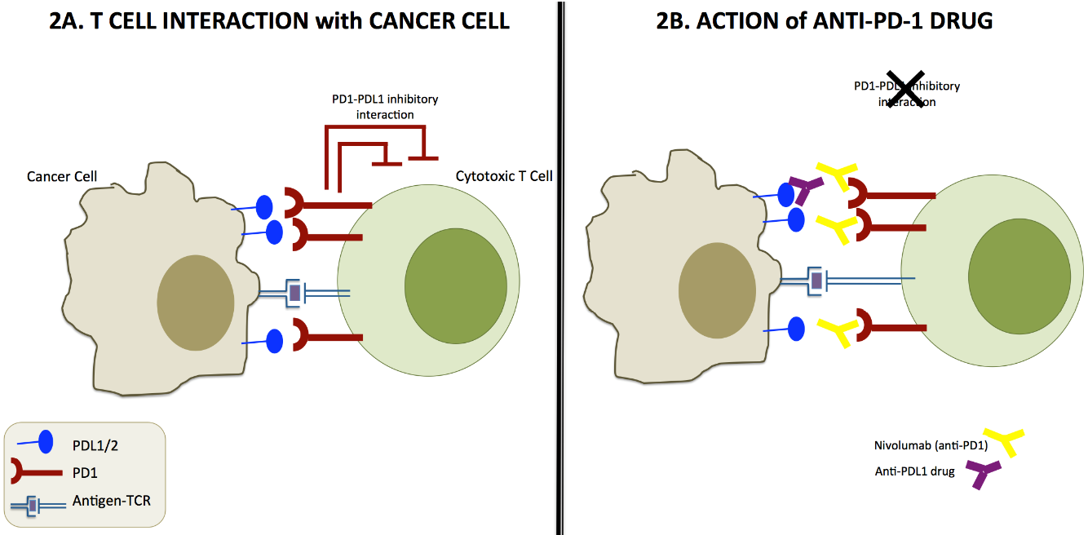
Immunotherapy checkpoint inhibitors: the New Players in the NSCLC space
Checkpoint inhibitors: tumors express “checkpoint” proteins on their cell surface to escape detection from the immune system; targeted inhibition towards these receptors enhances T cell response towards the tumor
(source: taken from:
http://sitn.hms.harvard.edu/flash/2014/blocking-the-brakes-helping-your-immune-system-battle-cancer/
Notes:
Slide provides a general background on the mechanisms of action of PD-1 and PD-L1 inhibitors
Nivolumab is an anti-checkpoint inhibitor
Tumors express “checkpoint” proteins on their cell surface, escaping detection from the immune system; targeted inhibition towards these receptors enhances T cell response towards the tumor – refer to the schematic on the left
As shown in the schematic to the right, nivolumab binds to the PD-1 receptor of the cytotoxic T cell, blocking its interaction with PD-L1 and PD-L2 on the cancer cell. The interaction between nivolumab and the PD-1 receptor releases PD-1 pathway-mediated inhibition of the immune response.
Nivolumab (Opdivo) is one of many immunotherapy checkpoint inhibitors used or in development for treatment of patients with Non-Small Cell Lung Cancer, others will be discussed later during this webinar

Slide 6
PD-L1Expression as a Potential Biomarker
Expression of PD-L1 on tumor-infiltrating immune cells or tumor cells may potentially be used as a biomarker to predict anti-tumor response to PD-1 / PD-L1 inhibitors
Several clinical trials are assessing the role of PD-L1 expression on the clinical activity of PD-1 / PD-L1 inhibitors to determine if higher expression correlates definitively with increased clinical activity (discussed in the following slides) and, if so, what the implications are for the effective and appropriate use of anti-PD1s in patients who are PD-L1+ or who are PD-L1 -
Notes:
PD-L1 expression may correlate with greater outcomes when treated with an anti-PD-1 or anti-PD-L1.
As will be discussed later, several clinical trials are examining the relationship between PD-L1 expression in tumors and clinical activity of PD-1 / PD-L1 inhibitors.

Slide 7
Checkpoint inhibitor nivolumab was approved by the FDA to treat patients with squamous NSCLC as subsequent therapy
CheckMate 017 Trial
Phase III, randomized, open-label study (n=272), nivolumab vs. docetaxel; metastatic squamous NSCLC, disease progression during or after one prior platinum doublet based chemotherapy
Median Overall Survival (OS) = 9.2 months on nivolumab (n=132) vs. 6.0 months on docetaxel (n=137)
CheckMate 063 Trial
Phase II, single-arm study, nivolumab (n=117); progression after a platinum-based therapy and at least one additional systemic treatment
Objective Response Rate (ORR) = 15%, all partial responses, median time to onset of response = 3.3 months
76% (13 of 17 patients) with a confirmed response had ongoing responses, 10 of the 17 had durable responses of 6 months or longer
Common adverse events (in at least 20% of patients, reported from Phase II trial): fatigue, dyspnea, musculoskeletal pain, decreased appetite, cough, nausea, and constipation
sources: label; Rizvi, et al. The Lancet Oncology 2015: 16(3): 257-265.; ClinicalTrials.gov, NCT01642004, NCT01721759
Notes:
Bristol-Myers Squibb’s nivolumab (Opdivo) was approved by the FDA to treat patients with metastatic squamous non-small cell lung cancer (NSCLC) with progression on or after platinum-based chemotherapy. Approval was based on two trials:
Checkpoint 017 and Checkpoint 063
Checkpoint 017 was a Phase III, randomized, open-label study comparing nivolumab versus docetaxel in patients with metastatic NSCLC who has experienced disease progression during or after one prior platinum doublet based chemotherapy. Nivolumab was administered at 3 mg/kg every two weeks, docetaxel was administered at 75 mg/m2 every 3 weeks.
Study included 272 patients regardless of PD-L1 status; PD-L1 is a biomarker, expression of which is used to gauge the potential effectiveness of the PD-1 / PD-L1 inhibitors against the tumor
Investigators ended the trial early, nivolumab met its primary endpoint of overall survival; statistically significant improvement in Median Overall Survival (OS) = 9.2 months on nivolumab (n=132) vs. 6.0 months on docetaxel (n=137)
Checkpoint 063 was a Phase II, single arm study in patients with metastatic squamous NSCLC who had progressed after receiving a platinum-based therapy and at least one additional systemic treatment
The study included 117 patients regadless of PD-L1 status, patients received 3 mg/kg of nivolumab
Objective response rate (ORR), as measured by RECIST, and Duration of Response were measured
Objective Response Rate (ORR) = 15%, all were partial responses, median time to onset of response = 3.3 months
76% (13 of 17 patients) with a confirmed response had ongoing responses, 10 of the 17 had durable responses of 6 months or longer
Common adverse events in at least 20% of patients (reported from Phase II trial): fatigue, dyspnea, musculoskeletal pain, decreased appetite, cough, nausea, and constipation
Prior to its NSCLC approval, nivolumab was approved by the FDA to treat patients with unresectable or metastatic melanoma following treatment with ipilimumab (Yervoy), or a BRAF inhibitor if the patient has a BRAF V600 mutation.
sources: label; Rizvi, et al. Activity and safety of nivolumab, an anti-PD-1 immune checkpoint inhibitor, for patients with advanced, refractory squamous non-small-cell lung cancer (CheckMate 063): a phase 2, single-arm trial. The Lancet Oncology 2015: 16(3): 257-265.; ClinicalTrials.gov, NCT01642004, NCT01721759

Slide 8
Nivolumab is being studied for additional indications in Non-Squamous Non-Small Cell Lung Cancer
CheckMate 057 Trial
Pivotal Phase III, randomized, open-label study (n=582), nivolumab vs. docetaxel in previously treated patients with advanced non-squamous NSCLC
Median OS = 12.2 months with nivolumab compared to 9.4 months with docetaxel
ORR was 19% vs. 12% and median DOR was 17.2 months vs. 5.6 months with nivolumab vs. docetaxel, respectively
Higher PD-L1 expression correlated with higher improved survival; PD-L1 expression > 1% in tumor cells improved median OS by 41%; no difference in survival in PD-L1 non-expressors
Nivolumab had a better adverse event profile compared to docetaxel; Grade 3-4 AEs were 10% with nivolumab vs. 54% with docetaxel
Trial stopped early because the study met its primary endpoint of superior overall survival
Other selected ongoing trials:
Development Phase | NSCLC Histology (squamous or non-squamous) | NSCLC Stage | Line of Therapy | Mono / Combo | Primary Completion | Notes
Phase III (CheckMate 026) | Both | Stage IV | 1st Line | Monotherapy | August 2016 | PD-L1+ status
Phase II | Both | advanced, metastatic | 2nd Line | Combination | August 2017 | EGF816 or capmatinib)
sources: J Clin Oncol. 2015 33 (suppl; abstr LBA 109); clinicaltrials.gov NCT02041533, NCT02323126
Notes:
In addition to its FDA approved indication for treating patients with squamous NSCLC, nivolumab is being studied for additional indications.
Bristol-Myers Squibb (BMS) is seeking a broader use for nivolumab 2nd line in patients with advanced NSCLC. Bristol-Myers Squibb’s pivotal CheckMate 057 is a randomized, open-label trial studying nivolumab against docetaxel in previously treated patients with advanced non-squamous NSCLC.
The trial was stopped early as a result of impressive overall survival results:
Median OS = 12.2 months with nivolumab compared to 9.4 months with docetaxel
ORR was 19% vs. 12% and median DOR was 17.2 months vs. 5.6 months with nivolumab vs. docetaxel respectively
Higher PD-L1 expression correlated with higher improved survival; PD-L1 expression > 1% in tumor cells improved median OS by 41%; no difference in survival in PD-L1 non-expressors suggesting that PD-L1 expression could be predictive of benefit with PD-1 inhibitors
Nivolumab had a better adverse event profile compared to docetaxel; Grade 3-4 AEs were 10% with nivolumab vs. 54% with docetaxel; all-grade AEs were 69% with nivolumab vs. 88% with docetaxel
BMS is also pursuing a 1st line indication for nivolumab in patients with later-stage NSCLC, for both non-squamous and squamous histologies.
CheckMate 026 Clinical trial is an open-label, randomized Phase III trial of nivolumab versus investigator’s choice of chemotherapy for 1st line use in patients with stage IV NSCLC.
Primary endpoint is progression-free survival (PFS)
Secondary endpoints include Objective Response Rate (ORR) and Overall Survival (OS)
This study will also measure PD-L1 expression – a potential biomarker that may be used to predict clinical response to PD-1 / PD-L1 inhibitors
The estimated primary completion date for this study is August 2016
Nivolumab is also being studied in combination with a number of agents in development, including EGF816, a third generation EGFR inhibitor, or capmatinib, a c-Met inhibitor; this study is a collaboration between BMS and Novartis
Combination trial is a Phase II, open-label study in previously treated patients with advanced, metastatic NSCLC
Patients with EGFR-mutated NSCLC with receive nivolumab in combination with EGF816; patients with c-Met positive NSCLC will receive nivolumab in combination with capmatinib
Primary endpoint is PFS
Secondary endpoints include the number of participants with Adverse Events, ORR, Disease Control Rate (DCR), and OS
Estimated primary completion date for this study is August 2017
sources: J Clin Oncol. 2015 33 (suppl; abstr LBA 109); clinicaltrials.gov NCT02041533, NCT02323126

Slide 9
Additional PD-1 / PD-L1 inhibitors in development to treat patients with NSCLC
Merck’s Pembrolizumab (Keytruda): Human monoclonal antibody directed against the programmed death-1 (PD-1) receptor of the T Cell; binding to PD-1 blocks its interaction with programmed cell death ligand 1 (PD-L1) and PD-L2 on the tumor cell; pembrolizumab received breakthrough designation by the FDA; FDA approved for melanoma
anti- PD-1
Genentech’s MPDL3280A: Human monoclonal antibody directed against programmed cell death ligand 1 (PD-L1). PD-L1 binds to the PD-1 receptor, releasing PD-1 pathway-mediated inhibition of the immune response, including the anti-tumor immune response
anti- PD-L1
AstraZeneca’s MEDI4736: Human monoclonal antibody directed against programmed cell death ligand 1 (PD-L1). PD-L1 binds to the PD-1 receptor, releasing PD-1 pathway-mediated inhibition of the immune response, including the anti-tumor immune response
Notes:
Other PD-1 / PD-L1 inhibitors are in late-stage development for treating patients with advanced, metastatic NSCLC. They include:
Merck’s pembrolizumab (Keytruda) is already FDA approved to treat patients with unresectable or metastatic melanoma following treatment with ipilimumab (Yervoy), or a BRAF inhibitor if the patient has a BRAF V600 mutation.
Merck’s pembrolizumab is a human monoclonal antibody directed against PD-1. Binding to PD-1 blocks the interaction with programmed cell death ligand 1 (PD-L1) and PD-L2 on the tumor cell releasing PD-1 pathway-mediated inhibition of the immune response and the anti-tumor immune response
Pembrolizumab received breakthrough designation by the FDA; breakthrough designation is given to a drug or biologic where preliminary clinical evidence indicates that the drug may demonstrate substantial improvement on a clinically significant endpoint(s) over available therapies
Two anti-PD-L1 inhibitors in late-stage development for the treatment of advanced, metastatic NSCLC include MEDI4736 and MPDL3280A.
Unlike nivolumab or pembrolizumab, MEDI4736 and MPDL3280A release PD-1 pathway-mediated inhibition by binding to the programmed cell death ligand 1 (PD-L1) protein on the cancer cell

Slide 10
Pembrolizumab - KEYNOTE-001 study
Phase I study to evaluate safety, side-effect profile, and antitumor activity of pembrolizumab as monotherapy in patients with advanced NSCLC
Define and validate expression level of PD-L1, a potential biomarker that may indicate response
Common side effects: fatigue, pruritis, and decreased appetite
Results (n=495 patients)
Endpoint | Overall (regardless of PD-L1 expression | PD-L1 expression > 50%
Median PFS | 3.7 months | 6.3 months
ORR | 19.4% | 45.2%
Median OS | 12.0 months | Median OS not reached
Pembrolizumab received FDA’s Breakthrough Designation for the treatment of patients with NSCLC and on April 2015, Merck submitted a supplemental BLA to the FDA for pembrolizumab in advanced NSCLC
Notes:
Pembrolizumab was studied in a Phase I trial (KEYNOTE-001) in patients with advanced NSCLC who were either treatment-naïve or previously treated. Results of the trial were impressive:
KEYNOTE-001 is a Phase I, randomized, open-label study assessing safety and efficacy of pembrolizumab in patients with advanced NSCLC (both squamous and non-squamous); in addition, investigators aimed to define and validate expression levels of PD-L1
495 patients received either 2mg/kg or 10mg/kg every 3 weeks or 10 mg/kg every 2 weeks; PD-L1 expression in tumor samples was reported as the percent of tumor cells with PD-L1 membrane staining
Overall median PFS was 3.7 months, ORR was 19.4 %, and median OS was 12 months; patients with NSCLC that had were PD-L1+ (> 50%), median PFS was 6.3 months, ORR was 45.2%, and the median OS has not been reached.
There was no significant difference in efficacy or side effects between patients receiving the 10mg/kg every two weeks versus 10 mg/kg every three weeks; data is limited for the 2mg/kg dose.
Based on this study, the FDA granted pembrolizumab breakthrough status.
This past April, Merck submitted a supplemental BLA for pembrolizumab for treatment of patients with NSCLC
Pembrolizumab demonstrated improved efficacy with PD-L1 expression levels of >50%
(sources: Garon EB, et al. Pembrolizumab for the Treatment of Non-Small Cell Lung Cancer. N Engl J Med 2015; 372:2018-2028; clinicaltrials.gov, (NCT01295827); Merck Press Release, April 19, 2015, http://www.mercknewsroom.com/news-release/oncology-newsroom/treatment-advanced-non-small-cell-lung-cancer-nsclc-keytruda-pembroli )

Slide 11
Pembrolizumab – additional studies for the treatment of NSCLC
KEYNOTE-042 Trial
Phase III, randomized, open-label, target of 1,240 patients (Clinical Trial NCT02220894) – 1st line monotherapy for advanced or metastatic NSCLC
Pembrolizumab vs. platinum doublet chemotherapy in treatment-naïve patients with PD-L1 expression
Primary Endpoint: OS; Secondary Endpoint: PFS
Patients with EGFR-sensitizing mutation and/or echinoderm microtubule-associated protein-like 4(EML4) gene/ALK gene fusion positive are excluded
Primary Completion Date: June 2018
KEYNOTE-021 Trial
Phase I/II, randomized, open-label, estimated enrollment of 308 patients (Clinical Trial NCT02039674)
Pembrolizumab in combination with chemotherapy or immunotherapy (ipilimumab) in participants with unresectable or metastatic non-small cell lung cancer (NSCLC)
Primary Endpoints: PFS, ORR; Secondary Endpoint: OS
Primary Completion Date: November 2016
pembrolizumab + ipilimumab results look promising: ORR = 55% (6 out of 11), Disease Control Rate (DCR) = 100% (n=11)
(sources: ClinicalTrials.gov, Trials NCT02220894 and NCT02039674; 2015 ASCO Abstracts: J Clin Oncol 33, 2015 (suppl; abstr TPS8105); J Clin Oncol 33, 2015 (suppl; abstr 8011) )
Notes:
In addition to Merck’s KEYNOTE-001 study, there are a number of ongoing clinical trials assessing pembrolizumab for the treatment of advanced, metastatic NSCLC:
KEYNOTE-042 trial is a larger Phase III, randomized, open-label study assessing pembrolizumab front-line as monotherapy against platinum doublet chemotherapy in treatment-naïve patients positive for PD-L1 expression
The trial’s main endpoint is overall survival, secondary endpoint if progression-free survival
The estimated primary completion date for this study is mid-2018
In addition to monotherapy studies, pembrolizumab is being studied in combination with a number of agents.
KEYNOTE-021 is assessing pembrolizumab in combination with either chemotherapy or another immunotherapy, ipilumumab in patients with unresectable or metastatic NSCLC.
Ipilumumab is another checkpoint inhibitor that binds to the cytotoxic T-lymphocyte-associated antigen 4 (CTLA-4) on T cells. Blocking CTLA-4 from interacting with its ligands augments a T cell immune response to tumor cells
Primary endpoints for this study are PFS and ORR. Overall survival is a secondary endpoint for this study.
Estimated primary completion date for this study is November 2016.
Although the sample size is small, results for pembrolizumab + ipilumumab look promising.
Overall Response Rate is 55%, Disease Control Rate is 100%

Slide 12
MPDL3280A – POPLAR Study
Phase II POPLAR study (NCT01903993): randomized study comparing MPDL3280A vs. docetaxel in previously treated patients with NSCLC
Greater PD-L1 expression correlated with a better clinical response; benefit not as great with lower PD-L1 expression
Out of 277 patients evaluable for safety, fewer patients (43%) experienced Grade > 3 adverse events on MPDL3280A compared to docetaxel (56%)
Results: Patients with highest PD-L1 expression
Endpoint | MPDL3280A (n=24) | Docetaxel (n=23)
Median OS | Not yet reached | 11.1 months
Median PFS | 9.7 months | 3.9 months
ORR | 38% | 13%
MPDL3280A was granted Breakthrough Therapy Designation by the FDA
(sources: ClinicalTrials.gov, NCT01903993; J Clin Oncol 33, 2015 (suppl; abstr 8010); Genentech Press Release, February 2014, http://www.gene.com/media/press-releases/14583/2015-02-01/fda-grants-breakthrough-therapy-designat)
Notes:
Genentech’s MPDL3280A is a PD-L1 inhibitor. Preliminary results from their Phase II POPLAR study comparing MPDL3280A versus docetaxel were impressive for MPDL3280A.
POPLAR Phase II study assessed MPDL3280A against docetaxel in previously treated patients with locally advanced or metastatic NSCLC who have failed platinum therapy.
The trial is a randomized, open-label study measuring overall survival (primary endpoint); secondary endpoints include patient reported outcomes, overall response, progression-free survival, and incidence of adverse events
Results demonstrated improved efficacy with higher PD-L1 expression (refer to table)
Even with a longer median treatment duration with MPDL3280A, fewer patients experienced Grade > 3 adverse events compared to docetaxel (43% vs. 56%, respectively)
MPDL3280A was granted Breakthrough Designation by the FDA in February 2015.

Slide 13
MPDL3280A - additional studies for the treatment of NSCLC
FIR Trial
Phase II, non-randomized, single-group, open label study, 138 patients
MPDL3280A monotherapy to treat patients with stage IIIb, IV, or recurrent NSCLC and are PD-L1+
Primary endpoint: Objective Response
Secondary endpoints: DOR, PFS, Safety (e.g. Adverse Events)
Preliminary results showed clinical efficacy in both chemo-naïve and previously treated patients with NSCLC; high PD-L1 expression was associated with higher ORR
Estimated Primary Completion date: June 2016
OAK Trial
Phase III, randomized, open label study, estimated enrollment of 1100 patients
MPDL3280A vs. docetaxel in previously treated patients with NSCLC after failure with platinum-containing chemotherapy (similar to POPLAR trial)
Primary endpoints: OS
Secondary endpoints: AEs, ORR, PFS, DOR
Estimated Primary Completion Date: June 2017
(sources: ClinicalTrials.gov, NCT01846416, NCT02008227; J Clin Oncol 33, 2015 (suppl; abstr 8028)
Notes:
Genentech’s MPDL3280A is undergoing a number of clinical trials as both monotherapy and in combination with other regimens. Two trials are shown in this slide:
FIR is a Phase II, non-randomized, single-group study assessing MPDL3280A in patients with stage IIIb or IV, or recurrent NSCLC. In addition patients included in this trial express PD-L1+.
Primary endpoint for this study is Objective Response
Secondary endpoints are Duration of Response, Progression-free Survival, and safety
Preliminary results demonstrate clinical efficacy in both chemo-naïve and previously treated patients with NSCLC; high PD-L1 expression was associated with higher ORR
The study’s estimated Primary Completion date is June 2016.
Similar to the POPLAR study, OAK is examining MPDL3280A versus docetaxel as 2nd line therapy in patients would have a platinum-containing chemotherapy. This is a larger scale, randomized, open-label Phase III trial with an estimated 1,100 patients being enrolled.
The primary endpoint for this trial is overall survival
Secondary endpoints include adverse events, overall response rate, progression-free survival, and duration of response
Estimated completion date for this trial is June 2017
In addition to these trials, Genentech is also studing MPDL3280A in a number of other trials as monotherapy in multiple lines, including 1st line, and in patients that are PD-L1+, as well as in combination with a variety of other agents (e.g. chemo +/- bevacizumab, INCB024360 (an inhibitor of indoleamine 2,3-dioxygenase)

Slide 14
MEDI4736
Phase I/II study to evaluate the safety, tolerability, and pharmacokinetics of MEDI4736 in patients with advanced solid tumors, including a NSCLC cohort
Preliminary Results, patients with advanced NSCLC with a median of 2.5 prior treatments, n=149 patients evaluable for response)
Endpoint | Overall | PD-L1+ | Squamous histology | Non-squamous histology
ORR | 14% | 23% | 21% | 10%
Disease Control Rate = 24%
Safety profile is manageable.
Overall Response Rate appears higher for patients that are PD-L1+; ORR appears higher for patients with squamous NSCLC vs. non-squamous NSCLC.
(sources: ClinicalTrials.gov, Trial NCT01693562; 2015 ASCO Abstract: J Clin Oncol 33, 2015 (suppl; abstr 8032))
Notes:
AstraZeneca’s MEDI4736, a PD-L1 inhibitor, is being assessed for safety and clinical activity in a Phase I/II study in patients with advanced solid tumors. The trial is a non-randomized, single-group, open-label study that includes patients with advanced NSCLC. The study contains a dose-escalation phase, followed by an expansion phase. For this particular cohort, patients were administered MEDI4736 at 10 mg/kg every 2 weeks.
Patients with NSCLC had a median of 2.5 prior treatments. 149 patients were evaluable for response.
The overall response rate was 14%. Patients with PD-L1+ status demonstrated a higher ORR at 23%.
Clinical activity appeared to be greater in patients with squamous NSCLC versus Non-squamous NSCLC.
Safety profile was considered manageable

Slide 15
MEDI4736 – additional studies for the treatment of NSCLC
Phase III: randomized, open-label, estimated enrollment of 900 patients (Clinical Trial NCT02352948) –advanced or metastatic NSCLC (ARCTIC study)
MEDI4736 versus standard of care in patients with PD-L1 positive tumors; MEDI4736 + tremilumumab versus standard of care in patients with PD-L1 negative tumors
Patients in the study should have received at least 2 prior systemic treatment regimens
Primary Endpoints: OS, PFS; Secondary Endpoints: ORR, DoR
Primary Completion Date: February 2017
Phase Ib: non-randomized, single-group, open-label, estimated enrollment of 258 patients (Clinical Trial NCT02000947) – combination with tremelimumab for the treatment of patients with advanced or metastatic NSCLC
Primary Endpoints: Maximum Tolerated Dose, dose-limiting toxicities, adverse events (AEs), serious adverse events (SAEs)
Secondary endpoints: Immunogenicity of tremelimumab in combination with MEDI4736 ; OR (Objective Response), DC (Disease Control), DoR, PFS, OS
As of December 2014, of 31 patients, 26% had partial response, 35% had stable disease. In patients with PD-L1 negative tumors, partial responses were observed in 3 out of 10 patients; combination appears to have a manageable safety profile
(sources: ClinicalTrials.gov, Trials NCT02352948, NCT02000947; 2015 ASCO Abstract: J Clin Oncol 33, 2015 (suppl; abstr TPS8104); J Clin Oncol 33, 2015 (suppl; abstr 3014))
Notes:
There are a number of ongoing clinical trials assessing AstraZeneca’s MEDI4736 for treatment of patients with advanced or metastatic NSCLC. Studies include MEDI4736 as monotherapy or in combination with other agents, including another immunotherapeutic. In addition, ongoing studies are assessing clinical activity in tumor types with PD-L1 expression. Two studies are represented in this slide:
Phase III, randomized, open-label study assessing MEDI4736 as monotherapy or in combination with the CTLA4 checkpoint inhibitor, tremelimumab for the treatment of patients with advanced or metastatic NSCLC that have received at least 2 prior systemic treatment regimens
Tremelimumab is an immunotherapeutic that binds to the CTLA4 protein
Primary endpoints include Overall Survival and progression-free survival, other endpoint include Overall Response rate and Duration of Response
Primary completion estimated date is February 2017
Phase Ib study is a non-randomized, single-group, open-label trial evaluating the safety and tolerability of MEDI4736 in combination with tremelimumab in patients with NSCLC. Clinical activity is also being studied.
Primary endpoints include maximum tolerated dose, dose-limiting toxicities, and adverse events; secondary endpoint include objective response, disease control, duration of response, progression-free survival, and overall survival
Preliminary results were reported, as of December 2014, of 31 patients, 26% had a partial response to the regimen while 35% had stable disease. In patients that were negative for PD-L1 expression, 3 out of 10 patients had partial responses
Safety profile of MEDI4736 + tremelimumab is manageable
Overall, MEDI4736 + tremelimumab displays clinical activity, even in patients that are PD-L1 negative.

Slide 16
NSCLC Immunotherapies
PD-1 and PD-L1 inhibitors – Key Takeaways
Nivolumab is currently being used to treat patients with metastatic squamous non-small cell lung cancer (NSCLC) with progression on or after platinum-based chemotherapy; results in patients with non-squamous NSCLC are impressive for those that express PD-L1
PD-L1 expression is being tested as a potential biomarker to predict anti-tumor response to PD-1 / PD-L1 inhibitors
Other PD-1 / PD-L1 inhibitors, including nivolumab, are being developed as monotherapy or in combination with other agents to treat NSCLC
Inhibitors are being developed for multiple lines of therapy
PD-1 / PD-L1 inhibitors are being studied in combination with a number of other agents including immunotherapies, cytotoxic agents, and targeted agents
Notes:
Key Takeaways
Nivolumab is currently being used to treat patients with metastatic squamous non-small cell lung cancer (NSCLC) with progression on or after platinum-based chemotherapy
PD-L1 expression is being tested as a potential biomarker to predict anti-tumor response to PD-1 / PD-L1 inhibitors
Other PD-1 / PD-L1 inhibitors, including nivolumab, are being developed as monotherapy or in combination with other agents to treat NSCLC
Inhibitors are being developed for multiple lines of therapy
PD-1 / PD-L1 inhibitors are being studied in combination with a number of other agents including immunotherapies, cytotoxic agents, and targeted agents
Preliminary results are promising

Slide 17
Real World Case Examples: Case Study 1
68yo female, current smoker, presented with a mass in her left lower leg
Biopsy showed poorly differentiated carcinoma
Staging showed a right lung mass, adrenal, and brain metastasis
Treated with gamma knife for brain metastasis
PS 2 because of fatigue
Started on chemotherapy and progression of disease after 2 cycles
Enrolled in a randomized trial between docetaxel and PD-L1 antibody
Randomized to the PD-L1 antibody

Slide 18
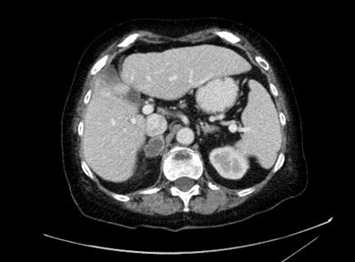
03/28/2013

Slide 19
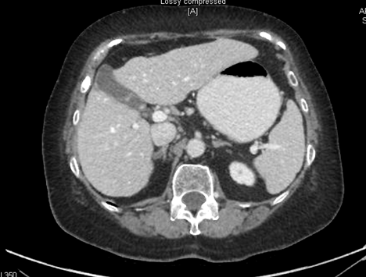
10/03/2013

Slide 20
Real World Case Examples: Case Study 2
55yo presented outside of our system with stage IV (cervical LN)
Smoker up to her diagnosis of 20pack/year
Pathology: Poorly differentiated NSCLC CK7 and p63 (+) TTF-1 (-) (3-25-2011)
Treated with combination of docetaxel+cisplatin+XRT (70Gy)

Slide 21
Case Study 2 (cont)
Trial of vaccine for 6 months until she had evidence progression
Performance status 1
Enrolled on a phase I clinical trial of a anti-PD-L1 antibody
First dose 3-20-2012

Slide 22
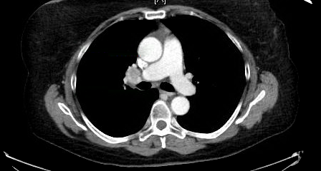
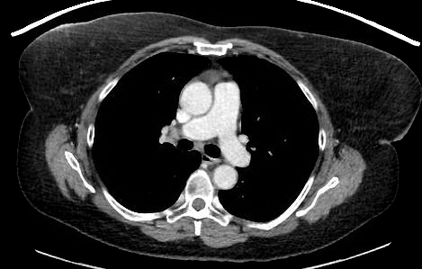
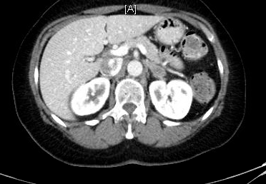
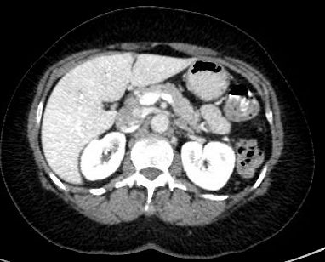
2-29-2012
4-29-2015

Slide 23
Case 3
70 yo with no smoking history presented with multiple pulmonary nodules.
Biopsy showed adenocarcinoma EGFR and ALK (-)
Broad molecular profiling showed amplification of TTF-1 and loss of CDKN2A but no “actionable mutation”
He has type II DM and mild chronic renal insufficiency

Slide 24
Case 3 (cont)
Patient wants to avoid hair loss and renal function does not allow the administration of pemetrexed
He receives therapy with carboplatin and gemcitabine with stable disease
Starts a phase II clinical trial of anti-PD-L1 antibody

Slide 25
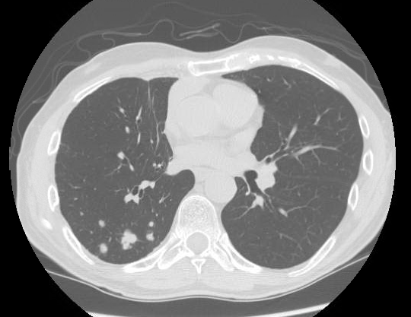
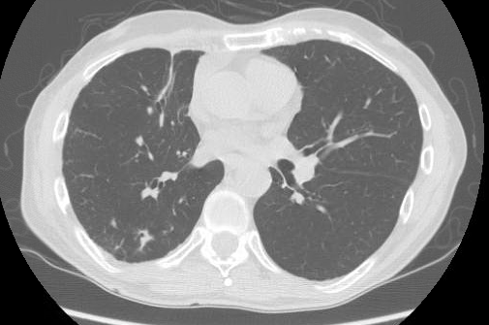
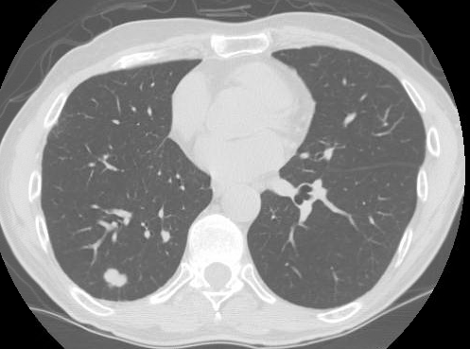
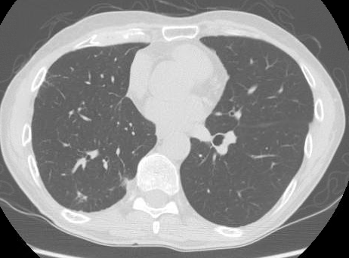
3-13-2014
6-04-2015

Slide 26
Questions?

Slide 27
Register Today!

Slide 28
Thank you for participating in the ICLIO e-Course. Presentation slides and archived recording will be available at accc-iclio.org

Slide 29
References
American Cancer Society
http://www.cancer.org/cancer/lungcancer-non-smallcell/
Antonia SJ, et al. Phase Ib study of MEDI4736, a programmed cell death ligand-1 (PD-L1) antibody, in combination with tremelimumab, a cytotoxic T-lymphocyte-associated protein-4 (CTLA-4) antibody, in patients (pts) with advanced NSCLC. J Clin Oncol 33, 2015 (suppl; abstr 3014)
ClinicalTrials.gov, A service of the U.S. National Institutes of Health
https://clinicaltrials.gov/ :Trials NCT02220894, NCT02039674, NCT01693562, NCT02352948, NCT02000947, NCT01903993, , NCT01846416, NCT02008227, NCT02041533, NCT02323126, NCT01642004, NCT01721759, NCT01295827
Garon EB, et al. Pembrolizumab for the Treatment of Non-Small Cell Lung Cancer. N Engl J Med 2015; 372:2018-2028
Genentech Press Release, February 2014,http://www.gene.com/media/press-releases/14583/2015-02-01/fda-grants-breakthrough-therapy-designat
Merck Press Release, April 19, 2015
http://www.mercknewsroom.com/news-release/oncology-newsroom/treatment-advanced-non-small-cell-lung-cancer-nsclc-keytruda-pembroli
Mok, T. et al. Phase 3 KEYNOTE-042 trial of pembrolizumab (MK-3475) versus platinum doublet chemotherapy in treatment-naïve patients (pts) with PD-L1-positive advanced non-small cell lung cancer (NSCLC). J Clin Oncol 33, 2015 (suppl; abstr TPS8105)
NCCN Clinical Practice Guidelines in Oncology, Non-Small Cell Lung Cancer
http://www.nccn.org/professionals/physician_gls/f_guidelines.asp
Opdivo (nivolumab) FDA approved Label / Prescribing Information

Slide 30
References (cont.)
Patnaik, A., et al. Phase I study of pembrolizumab (pembro; MK-3475) plus ipilimumab (IPI) as second-line therapy for advanced non-small cell lung cancer (NSCLC): KEYNOTE-021 cohort D. J Clin Oncol 33, 2015 (suppl; abstr 8011) )
Paz-Ares, LG. et al. Phase III, randomized (CheckMate 057) of nivolumab (NIVO) versus docetaxel (DOC) in advanced non-squamous cell (non-SQ) non-small cell lung cancer (NSCLC). J Clin Oncol. 2015;33 (suppl; abstr LBA109)
Planchard, D., et al. A phase III study of MEDI4736 (M), an anti-PD-L1 antibody, in monotherapy or in combination with Tremelimumab (T), versus standard of care (SOC) in patients (pts) with advanced non-small cell lung cancer (NSCLC) who have received at least two prior systemic treatment regimens. J Clin Oncol 33, 2015 (suppl; abstr TPS8104)
Rizvi, NA. et al. Safety and clinical activity of MEDI4736, an anti-programmed cell death-ligand 1 (PD-L1 antibody, in patients with non-small cell lung cancer (NSCLC). J Clin Oncol 33, 2015 (suppl; abstr 8032)
Rizvi, NA. et al. Activity and safety of nivolumab, an anti-PD-1 immune checkpoint inhibitor, for patients with advanced, refractory squamous non-small-cell lung cancer (CheckMate 063): a phase 2, single-arm trial. The Lancet Oncology 2015; 16(3):257-265.
Seer Cancer Statistics
http://seer.cancer.gov/statfacts/html/lungb.html
SITN science in the news
http://sitn.hms.harvard.edu/flash/2014/blocking-the-brakes-helping-your-immune-system-battle-cancer/
Spigel, DR. Clinical activity and safety from a phase II study (FIR) of MPDL3280A (anti-PDL1) in PD-L1-selected patients with non-small cell lung cancer (NSCLC). J Clin Oncol 33, 2015 (suppl; abstr 8028)
Spira, AI. Efficacy, safety and predictive biomarker results from a randomized phase II study comparing MPDL3280A vs docetaxel in 2L/3L NSCLC (POPLAR). J Clin Oncol 33, 2015 (suppl; abstr 8010)

