Slide 1
Navigating Immuno-Oncology Coverage & Reimbursement Issues
Niesha Griffith, RPh, MS, FASHP Administrator of Oncology Pharmacy and Infusion Services at the Arthur G. James Cancer Hospital and Richard J. Solove Research Institute at The Ohio State University
Bill McGivney, PhD
Principal of McGivney Global Advisors
August 27, 2015 12 -1 p.m. EST
ICLIO e-Course 03

Slide 2
e-Course Overview
Section 1: Bill McGivney, PhD
General Environment in Coverage and Reimbursement
Determination of Coverage and Reimbursement for I-O Agents
Compendia
Present Coverage for I-O agents
Impact of new Oncology Value Metrics
Section 2
Niesha Griffith, RPh, MS, FASHP
Institutional Considerations and Needs in Coverage and Reimbursement
Assurance of explicit, timely, and clear coverage policies including off-label use
Internal demand for use of I-O agents
Reimbursement issues

Slide 3
Bill McGivney, PhD McGivney Global Advisors

Slide 4
How Did We Get Here? From “Medically-Accepted” to “Outcomes-Based” Coverage Policy
1991: Aetna rewrites contractual language, makes outcomes-based, and files in most states
Payers elevate coverage policies and institute precert programs
The HDCT/ABMT Battle
Payers back off cancer care: Providers, “60 Minutes”, Employers and the Courts ($120 million)
2004: “Cost of Chemotherapy for Cancer” (Schrag, NEJM 2004); “financial toxicity” (Saltz)
Is $100,000 now the pricing floor? Payers now must control and manage drugs and biologics.

Slide 5
Policy-Setting and Decision-Making “FlowDown”
FDA Approved Label with Indication
NCCN On-label; Expanded Use (Recommendation, Preferred Status, Category)
Payer/MCO (coverage, precert etc.)
Pathways
Provider Prescribing

Slide 6
NCCN Guidelines and Other Information Products
1996
2005
2005
2007
2009
2012
NCCN Guidelines launched at NCCN Annual Conference
NCCN International Collaboration begins in China
NCCN Patient Guidelines Launched
NCCN Drugs and Biologics Compendium launched
NCCN Order Templates Launched
NCCN BioMarkers Compendium Launched

Slide 7
2008: A Win for Oncology Providers and Patients
Jan, 16 2008 – United Press Release: If it is in NCCN Compendium, we pay for it!
June 5, 2008 (4:16pm): CMS recognizes the NCCN Compendium
The NCCN Compendium becomes the critically important to oncologists, cancer patients and biopharma companies
Sept 30, 2014: CIGNA confirmation still using NCCN Compendium
The NCCN Compendium flipped cancer decision-making 180 degrees

Slide 8
NCCN Categories
Quality of Evidence | Level of Consensus | NCCN Category
High (e.g. RCT, MA) | Uniform | 1 (6%)
Lower (e.g. single arm) | Uniform | 2A (87%)
Lower (e.g. cohort analysis) | Consensus | 2B (6%)
Any (e.g. RCT, single arm) | Major disagreement | 3 (rare)

Slide 9
NCCN Categories and Payer Response
NCCN Category 1
United = Yes
Aetna = Yes
Cigna = Yes
Anthem = Yes
Medicare = Yes
NCCN Category 2A
United = Yes
Aetna = Yes
Cigna = Yes
Anthem = Yes
Medicare = Yes
NCCN Category 2B
United = Yes
Aetna = Yes
Cigna = Yes
Anthem = No
Medicare = Silent

Slide 10
United HealthCare: Medical Benefit
Description:
This policy provides parameters for coverage of injectable oncology medications (J9000 - J9999) and select other medications used for oncology conditions [including, but not limited to octreotide acetate (J2353 and J2354) and leuprolide acetate (J1950)] covered under the medical benefit based upon the National Comprehensive Cancer Network (NCCN) Drugs & Biologics Compendium™. The Compendium lists the appropriate drugs and biologics for specific cancers using US Food and Drug Administration (FDA)-approved disease indications and specific NCCN panel recommendations. Each recommendation is supported by a level of evidence category.
Coverage Rationale:
UnitedHealthcare recognizes indications and uses of injectable oncology medications listed in the NCCN Drugs and Biologics Compendium with Categories of Evidence and Consensus of 1, 2A, and 2B as proven and Categories of Evidence and Consensus of 3 as unproven. (However, see below for Benefit Considerations.)

Slide 11
United HealthCare: Pharmacy Benefit
This policy provides parameters for coverage of specific oral oncology medications covered under the pharmacy benefit based upon the National Comprehensive Cancer Network (NCCN) Drugs & Biologics Compendium™. The Compendium lists the appropriate drugs and biologics for specific cancers using US Food and Drug Administration (FDA)-approved disease indications and specific NCCN panel recommendations. Each recommendation is supported by a level of evidence category.
UnitedHealthcare recognizes indications and uses of oral oncology medications listed in the NCCN Drugs and Biologics Compendium with Categories of Evidence and Consensus of 1, 2A, and 2B as proven and Categories of Evidence and Consensus of 3 as unproven

Slide 12
Oncology Drug/Biologic Compendia recognized by Payers
Clinical
Pharmacology
AHFS® DI
DrugDex®
NCCN
$$√$$
$$√$$
$$√$$
$$√$$
$$√$$
$$√$$
$$√$$
$$√$$
$$√$$
$$√$$
$$√$$
$$√$$
$$√$$
$$√$$
$$√$$
$$√$$
Compendia listed above are recognized by Medicare Parts B & D;
Medicaid recognizes AHFS DI and DrugDex

Slide 13
Aetna Coverage Policy for Nivolumab and Pembrolizumab (as of August 12, 2015 )
Nivolumab** (last Aetna review April 10, 2015)
Covered for incompletely resected or unresectable metastatic or recurrent melanoma
Covered for squamous NSCLC with progression on or after chemotherapy
**Requires preauthorization
Pembrolizumab (last Aetna review April 10, 2015)
Covered for incompletely resected or unresectable metastatic or recurrent melanoma

Slide 14
Anthem Coverage Policy for Nivolumab and Pembrolizumab (as of August 12, 2015 )
Nivolumab (last Anthem review August 6, 2015)
Covered for incompletely resected or unresectable metastatic or recurrent melanoma in first line either as monotherapy or in combination with ipilumumab (before NCCN) and as monotherapy for second line or subsequent therapy for documented disease progression
Covered for squamous NSCLC with progression on or after chemotherapy
Pembrolizumab (last Anthem review May 7, 2015)
Covered for incompletely resected or unresectable metastatic or recurrent melanoma as monotherapy in first-line or subsequent therapy for documented disease progression

Slide 15
Wisconsin Physician Service Medicare Policy for Nivolumab in NSCLC (as of August 12, 2015 )
Nivolumab Covered for squamous and nonsquamous metatstatic NSCLC with progression on or after platinum-based chemotherapy (Aug. 1 Newsletter)

Slide 16
Immuno-Oncology: Coverage Related Issues
Payer ability to keep up with accelerating data-based new indications (e.g., new lines of therapy, new tumor types)
Soon, there will be increasing utilization of anti-pd1s in combination with a host of agents (e.g., chemo, targeted, immunotherapeutic)
As number of marketed anti-pd1s and anti-pdl1s increases will step therapy specifications be embedded into precert criteria to specify preferred agents
Will coverage policy increasingly be biomarker driven (e.g., PDL1 overexpression)

Slide 17
Niesha Griffith, RPh, MS, FASHP
Administrator of Oncology Pharmacy and Infusion Services at the Arthur G. James Cancer Hospital and Richard J. Solove Research Institute at The Ohio State University
17

Slide 18
Pembrolizumab
Over 30 requests to date
No write-offs
Utilize Merck support program for all patients
0 received replacement assistance from Merck
2 patients received copay assistance
Indications
Metastatic melanoma (90%)
Lung
Cholangiocarcinoma
Renal cell
18

Slide 19
Nivolumab
Over 120 requests to date
No write-offs
Utilize BMS support program for all patients
19 patients received replacement assistance from BMS
8 patients received copay assistance
BMS copay support and disease based grants
Indications:
Metastatic Melonoma (42%)
Renal Cell (22%)
Lung (20%)
Squamous Cell Carcinoma (skin)
Non-Hodgkins Lymphoma
Bladder
Prostate
Merkel Cell
19

Slide 20
20

Slide 21
21

Slide 22
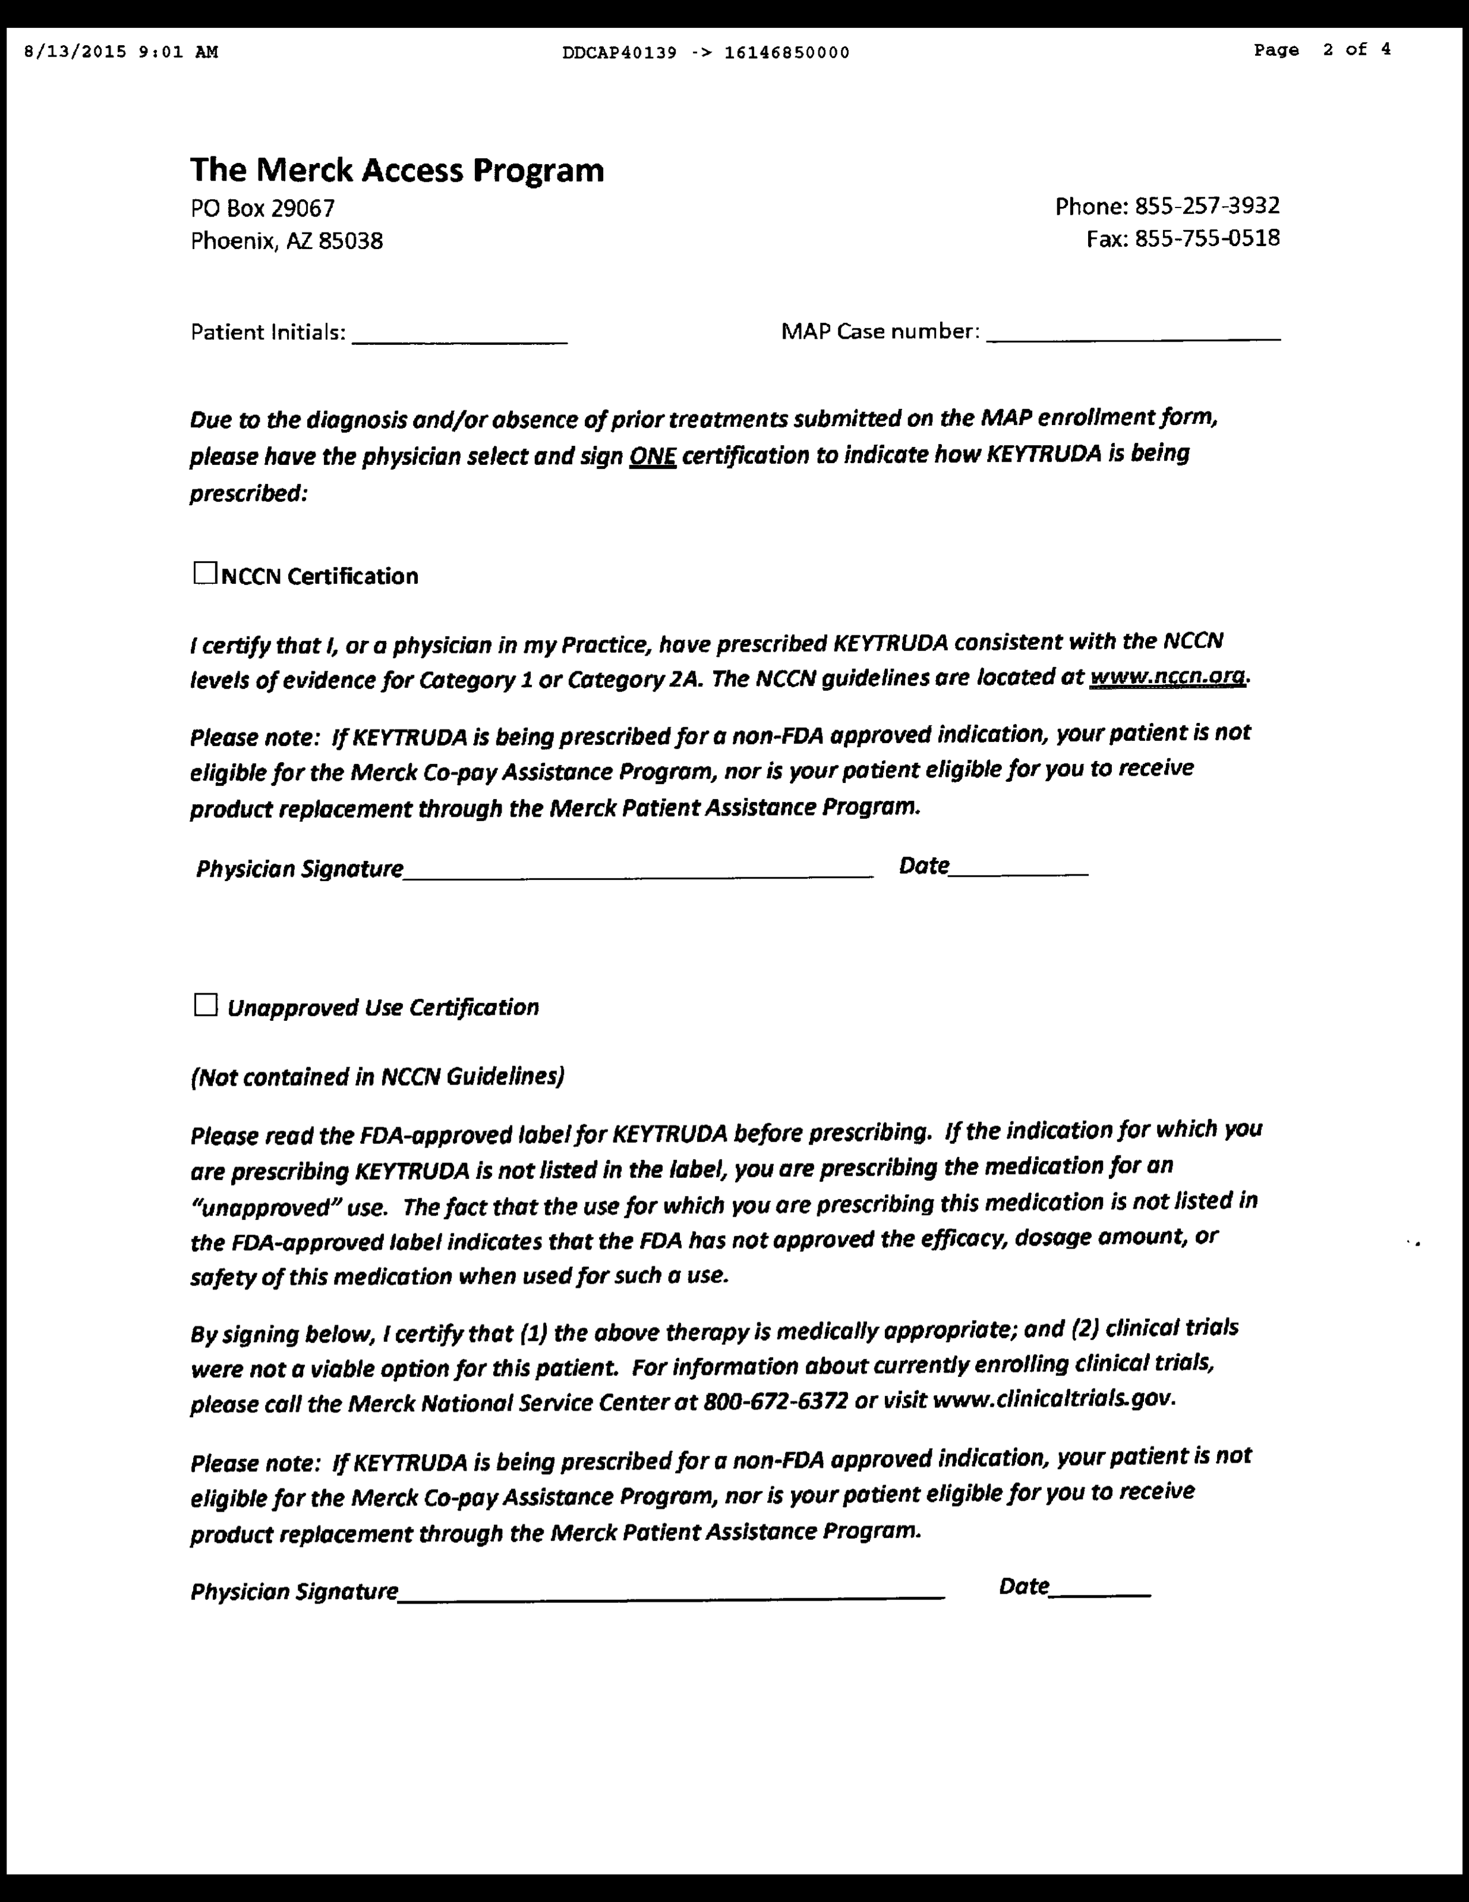
22

Slide 23
23

Slide 24
Support Program Experience
We use the support programs whether on or off-label for both medications
On-label requests follow our High Dollar Medication Process flow algorithm
Off-label requests follow either the Medicare or Other Payers Process flow algorithms
24

Slide 25
Payer Experience
Medicare
No LCD yet
Require signed ABN if off label
Managed Medicare
Clinical policy guidelines are available for all major payer plans
Require off-label predetermination
Off-label considered with clinical support and patient information, decisions on a case-by-case basis
Require NONC with unsuccessful predetermination
25

Slide 26
Payer Experience
Medicaid
Can not require NONC
If denied, only option is a support program
Managed Medicaid
Clinical policy guidelines are available (Caresource, Molina, etc.)
Require off-label predetermination
Off-label considered with clinical support and patient information, decisions on a case-by-case basis
Require signed NONC with unsuccessful predetermination
26

Slide 27
Payer Experience
Anthem, Humana, Aetna, Cigna
Clinical policy guidelines are available for all
Require off-label predetermination
Off-label considered with clinical support and patient information, decisions on a case-by-case basis
Require signed NONC with unsuccessful predetermination
Anthem appears to have most scrutiny and where we have seen the most denials even after pre-determination authorization
27

Slide 28
Payer Experience
United Health Care
Follows NCCN Guidelines
Require off-label predetermination
Off-label considered with clinical support and patient information, decisions on a case-by-case basis
Require signed NONC with unsuccessful predetermination
Patients willing to pay out-of-pocket, if necessary for entire therapy
28

Slide 29
Challenges
Requests for off-label use immediately following FDA approval
Payers initially not prepared to answer coverage questions and render decisions
Support programs are different
Testing requirement
Off-label support
Resource intense
Clinical team (physicians, pharmacists, APPs)
Reimbursement staff
29

Slide 30
Number of Off-Label Requests
30

Slide 31
Challenges
Communication/coordination due to multiple individuals and processes involved (internal/external)
Out of pocket payments
Budget impact
Current off-label use
Pending indications
Number of clinical trials
31

Slide 32
How have we made it work?
High dollar medication approval process
Enroll every patient into a support program, regardless of on or off-label
Clinical specialist pharmacist at point of care provides support and engages clinical team
Robust 0ff-Label Policy and Procedure
All off-label requests require predetermination
Patients are made aware of risks and benefits, including financial risk
Patients are required to sign an ABN or NONC
Utilize peer review process as necessary
32

Slide 33
How have we made it work?
Added Reimbursement Specialists to the Pharmacy Department
Handle all high dollar approvals
Submit manufacturer program application and perform precertification
Handle all off-label predeterminations
Engage directly with Clinical Specialist Pharmacists
Determine out of pocket payment amount when necessary
Pharmacy follows every claim to ensure payment
Developed detailed process flows
33

Slide 34
High Dollar Process
Treatment includes high dollar medication
Clinic nurse obtains signatures for Pharma reimbursement form from patient and prescriber
Pharma form is scanned to James reimbursement specialists (RS)
Pharma form is submitted to company by RS
On Label Request
Off Label Request
Full benefits investigation performed by Pharma services and referral to copay and PMAP resources provided if necessary
Patient coverage verified by RS
Denied
Refer to Off label policy and procedure
Request submitted to payer for approval
Approve
RS communicates with pharmacist and team once authorization is approved
Patient scheduled for therapy
Follow account to ensure payment and application of copay assistance
Medication Assistance Program Coordinator (MAPC) speaks with patient about benefits and need for copay or PMAP assistance
MAPC assists with copay or PMAP assistance
Coordinate with business office to submit copay grants
34

Slide 35
Predetermination Process
Formal process with a team approach
Key players:
Pharmacist
Physician
Advanced Practice Provider (CNP or PA)
Reimbursement Specialist
Effective and traceable form of communication is essential
35

Slide 36
Predetermination Process
Pharmacist role
Discuss rationale for off-label use with the team
Retrieve supporting literature
Review CMS approved compendia and NCD/LCD
Enter request into off-label use database
Entry triggers an email to pharmacy director, P&T committee chair, reimbursement specialist team
36

Slide 37
Predetermination Process
Reimbursement Specialist role
Verify medical insurance
Obtain copies of pertinent information from patient medical record (treatment plan, diagnostic studies, etc.)
Retrieve supporting literature (if not already provided by team)
Verify compendia and NCD/LCD support
Identify appropriate ICD-9 code(s) and HCPCS code(s) for medications
37

Slide 38
Predetermination Process
Reimbursement Specialist role
Draft letter of medical necessity
Fax letter and supporting evidence to payer
Confirm payer has received information
Continue to follow-up until approval/denial received
Request approval number and individual name
38

Slide 39
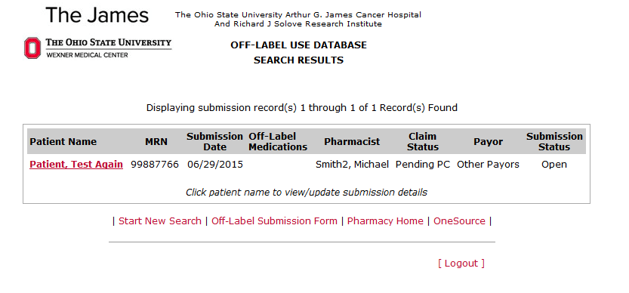
James Off Label Database
39

Slide 40
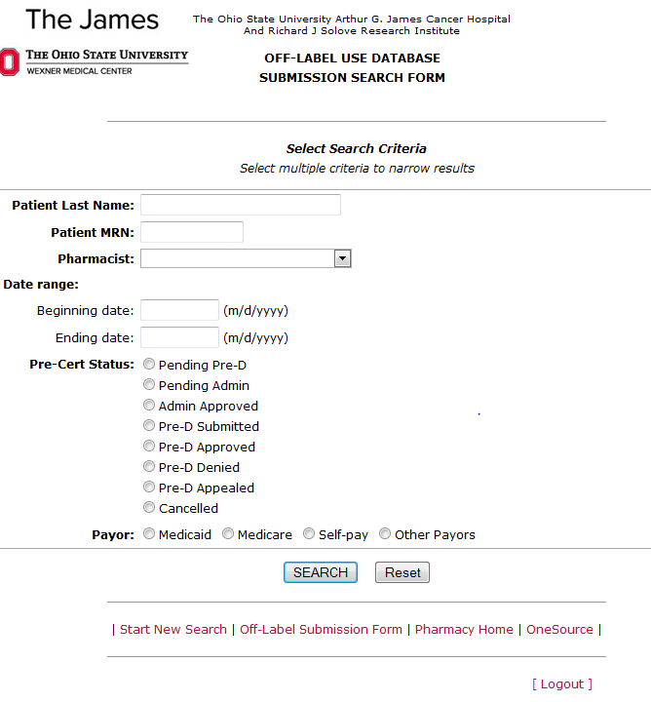
Key:
Pending Pre-D = waiting on reimbursement team
Pending Admin = Awaiting pharmacy administration review
Admin Approval = Administration approval
Pre-D = Pre-determination
40

Slide 41
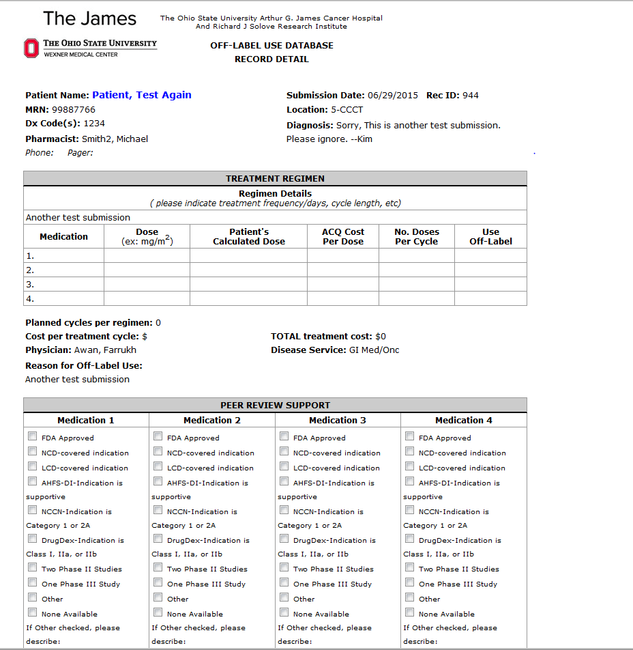
MRN: Medical Record Number
Dx Code: diagnosis code
41

Slide 42
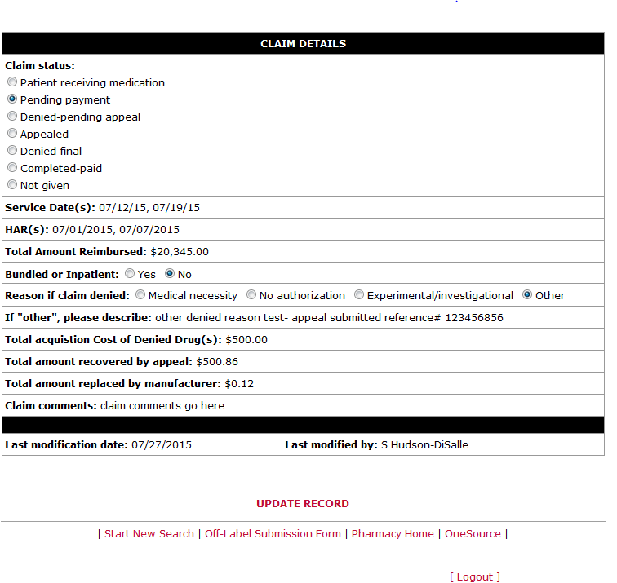
42

Slide 43
43

Slide 44
Peer Review Process
Off-label requests lacking supportive evidence require approval by:
Disease Specific Leader (GI, GU, Lung, etc..)
Division Director (hematology or oncology)
Pharmacy Administrator/Director
Safety, efficacy, and cost must be considered
Decisions may take up to 72 hours depending on availability of individuals
44

Slide 45
45

Slide 46
46

Slide 47
47

Slide 48
48

Slide 49
Questions?

Slide 50
Register today!
accc-iclio.org

