Slide 1
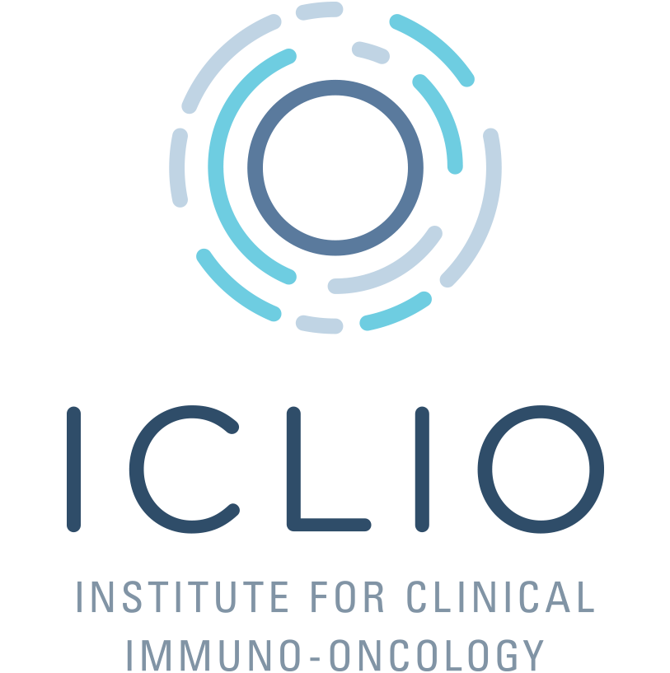
Immunotherapy in Melanoma: Use in Patients with Autoimmune Diseases
Christine M. Walko, PharmD, BCOP, FCCP
Personalized Medicine Specialist
Chair, Clinical Genomic Action Committee
Moffitt Cancer Center, Tampa, FL
accc-iclio.org
accc-iclio.org

Slide 2
Objectives
Review the current place in practice for immunotherapy in melanoma
Discuss the use of immunotherapy in patients with autoimmune conditions
accc-iclio.org
accc-iclio.org

Slide 3
Systemic Melanoma Treatment
Adjuvant therapy
Interferon α-2b or peginterferon α-2b
Ipilimumab 10 mg/kg every 3 weeks x 4 followed by every 12 weeks for up to 3 years
Select patients: Talimogene laherparepvec (T-VEC)
Metastatic disease
Immunotherapy – Aldesleukin (IL-2), ipilimumab, pembrolizumab, nivolumab
BRAF-pathway targeted therapy – vemurafenib, cobimetinib, dabrafenib, trametinib,
Chemotherapy – Dacarbazine, temozolomide, paclitaxel, combination therapy

Slide 4
Talimogene Laherparepvec (T-VEC)
Herpes simplex virus (HSV) type-1 derived oncolytic virus
Selectively replicates in tumor cells → Cell lysis
Phase III trial with 436 melanoma patients with stage IIIB to IV injectable melanoma sites not amenable to surgical resection
Response seen in both injected and uninjected lesions
Greatest benefit in stage IIIB/IIIC
 | T-VEC | GM-CSF | P-value
Durable Response Rate | 16.3% | 2.1% | <0.001
Overall Response Rate | 26.4% | 5.7% | Not available
Complete Response Rate | 10.8% | <1% | <0.001
Overall survival | 23.3 months | 18.9 months | 0.051
Andtbacka RH, et al. J Clin Oncol. 2015; 33:2780-8.
Notes:
ICP34.5 = the herpes virus neurovirulence gene
Deletion of ICP34.5: decreases viral pathogenicity and increases tumor-selective replication
Deletion of ICP47: decreases virally mediated antigen presentation suppression and increases expression of the HSV US11 gene
Engineered to express granulocyte-macrophage colony-stimulating factor (GM-CSF) to increase cancer immunity
Adverse effects were manageable with the most common being chills, pyrexia, injection site pain, nausea, flu-like illness and fatigue

Slide 5
Systemic Therapy Options for Metastatic Melanoma
First-line Therapy
Second-line or Subsequent
Nivolumab (category 1)
Pembrolizumab (category 1)
Nivolumab + Ipilimumab
For BRAF positive patients:
Dabrafenib + Trametinib (category 1)
Vemurafenib + Cobimetinib (category 1)
Clinical trial
First-line options not already used or clinical trial
Ipilimumab
Dacarbazine or temozolomide
High-dose IL-2
Biochemotherapy
Cytotoxic chemotherapy
Imatinib for C-KIT mutated tumors
(Source: NCCN Clinical Practice Guidelines in Oncology (NCCN Guidelines®) Melanoma V.1.2017 © National Comprehensive Cancer Network, Inc. 2016. All rights reserved. Accessed 04/18/2017.)

Slide 6
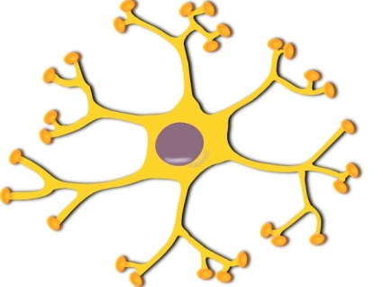
CTLA-4 and PD-1 Pathways
Lymph Node
Systemic Circulation
PD-1
PD-L1
CTLA-4
B7
Dendritic cell
Tumor Cell
T Cells
Ipilimumab: inhibits CTLA-4 on the T-cells
Pembrolizumab and Nivolumab inhibit PD-1 on the T-cells, preventing binding to PD-L1 on the tumor cells
Ultimately, prevents immune system downregulation

Slide 7
Comparison of Anti-PD-1 Agents
 | Pembrolizumab | Nivolumab
Initial FDA Approval Date | September 4, 2014 | December 22, 2014
Type of Antibody | Humanized, IgG4 kappa immunoglobulin | Human, IgG4 kappa immunoglobulin
Approved Dosing (single agent) | 2 mg/kg over 30 minutes every 3 weeks | 240 mg IV over 60 minutes every 2 weeks
Approved indication in unresectable or metastatic melanoma | Single agent in patients with unresectable or metastatic melanoma | Single agent or in combination with ipilimumab in patients with unresectable or metastatic melanoma
Pembrolizumab and nivolumab package inserts 2017
Notes:
Point out differences in pembrolizumab dosing vs approved dosing
NSCLC, HNSCC and cHL dosing for pembro is 200 mg every 3 weeks

Slide 8
All Grade Autoimmune Toxicities
Toxicity | Clinical Effects | Ipilimumab 3 mg/kg | PD-1 inhibitors | Time Frame
Skin | Rash, vitiligo, pruritus | 47-68% | 13-26% | 2-3 weeks
Gastrointestinal | Diarrhea, colitis | 31-46% | 14-19% | 6-7 weeks
Liver | Elevated enzymes, bilirubin, hepatitis | 3-9% | 1-4% | 6-7 weeks
Endocrine | Hypophysitis, hypothyroidism | 4-6% | 3-10% | After 9 weeks
Black box warning for autoimmune effects, however neither ipilimumab, pembrolizumab or nivolumab lists any specific contraindications.
Larkin J, et al. N Engl J Med. 2015;373:23-34.
Robert C, et al. N Engl J Med. 2015;372:2521-2532.
Weber JS, et al. J Clin Oncol. 2012; 30:2691-7.

Slide 9
Case Presentation: DC
DC is a 51-year-old male with rheumatoid arthritis who previously received certolizumab and now on prednisone 5 mg daily.
He presents with newly diagnosed stage IV melanoma involving the liver.
His tumor is BRAF wild-type (WT).
Can we use a checkpoint inhibitor for DC’s metastatic melanoma?
Notes:
TNF-alpha inhibitor
Infliximab, adalimumab, golimumab etanercept

Slide 10
Autoimmune Disorders and Cancer
More than 80 distinct autoimmune disorders
Localized to specific organ systems vs. systemic
3-8% of the US population estimated to have an autoimmune disorder
Unclear whether the process of an autoimmune disease and/or the therapies can increase the risk of cancer
Chronic inflammation
Chronic immunosuppression
Donia M, et al. Semin Immunopathol. 2017;39:333-337.

Slide 11
Ipilimumab in Autoimmune Diseases
Retrospective review of 30 patients with advanced melanoma and pre-existing autoimmune disorders treated with ipilimumab
Rheumatoid arthritis (n=6)
Psoriasis (n=5)
Inflammatory bowel disease, lupus, multiple sclerosis or thyroiditis (n=2 for each) and other (n=7)
43% were receiving autoimmune therapy concurrently
27% had autoimmune exacerbations necessitating steroid therapy
50% had no autoimmune flare or immune-related adverse events
Overall response = 20% (1 patient with durable CR)
Johnson, et al. JAMA Oncol. 2016;2(2):234-240.
Notes:
9 academic centers

Slide 12
Anti-PD-1 Therapy in Autoimmune Diseases
Retrospective trial of 52 melanoma patients with pre-existing autoimmune disorders treated with PD-1 inhibitors
Response rate = 33%
Flare requiring immunosuppression = 38%
Rheumatoid arthritis, polymyalgia rheumatica, Sjogren’s syndrome, psoriasis, and immune thrombocytopenic purpura
No flare was seen in patients with gastrointestinal (n=6) or neurological (n=5) disorders
Discontinuation due to flare = 2 patients
Menzies AM, et al. Ann Oncol. 2017; 28:368-76.

Slide 13
Patient Case: DC
PD-1 therapy is indicated for first-line therapy for metastatic melanoma
DC’s RA is well controlled
Would consider single agent pembrolizumab or nivolumab with close monitoring

Slide 14
Conclusions
Immunotherapy has revolutionized the treatment of melanoma, especially in the more advanced settings.
Immune related adverse events are unique to this class of agents and require early recognition and treatment
Evolving retrospective data has shown the safety of using certain immunotherapies in select patients with autoimmune disease, though close monitoring is required

Slide 15
Thank you for participating in the ICLIO e-Course. Presentation slides and archived recording will be available at accc-iclio.org.

