Slide 1
Immunotherapy for High-Risk and Metastatic Melanoma
Timothy M. Kuzel, MD
Professor of Medicine and Dermatology
Feinberg School of Medicine
Northwestern University
Chicago
ICLIO 1st Annual National Conference
10.2.15
Philadelphia, Pa.

Slide 2
Financial Disclosures
I currently have or have the following relevant financial relationships to disclose:
Advisory Board: Genentech
Consultant: Merck
Grant/Research Support: Bristol-Myers Squibb, Genentech, MedImmune, Merck
Speakers Bureau: Genentech

Slide 3
Off-Label Use Disclosures
I do intend to discuss off-label uses of products during this activity.

Slide 4
Therapeutic Targets in Metastatic Melanoma
Kit inhibitors
cKit
NRAS
IL-2
IFN-a
Anti-CD40
Anti-CD137
Anti-OX40
BRAF inhibitors
BRAF
MEK inhibitors
MEK
ERK
Antitumor immune
response
Oncogenic cell
proliferation
and survival
Anti-CTLA4
Anti-PD1
MEK = MAPK/ERK kinase; CTLA4 = cytotoxic T-lymphocyte antigen-4; PD1 = programmed death-1; IL-2 = interleukin-2; IFN-a = interferon alfa-2b.
Adapted from Fecher et al, 2007; Xing, 2010.

Slide 5
Relevance of Immunotherapy for the Treatment of Melanoma
FDA-approved immunotherapies for melanoma
  Adjuvant treatment
    High-dose IFN-a
    Pegylated IFN-a
  Metastatic melanoma
    High-dose IL-2
    Ipilimumab
    Anti PD-1 antibodies (nivolumab or pembrolizumab)
Immunotherapy has been demonstrated to re-producibly result in long-term responses (not immediate) in (a minority of) patients with metastatic melanoma
YervoyTM prescribing information, 2012; Proleukin® prescribing information, 2012; Sylatron® prescribing information, 2012; Intron-A® prescribing information, 2012; NCCN, 2012.
Notes:
Adjuvant treatment:
High dose interferon alpha 2b (Intron-A®)
Pegylated interferon alpha 2b (Sylatron®)
Metastatic melanoma:
High dose IL-2 (Proleukin®)
Ipilimumab (Yervoy®)

Slide 6
Select Ongoing Phase III Adjuvant Therapy Trials in Melanoma
Study | Author or Group | N | Data Expected
MM-ADJ-5 (standard HDI vs intermittent HDI) | Mohr | 660 | 2012
MM-ADJ-8 (pegIFN vs LDI) | Garbe | 880 | 2012/13
AVAST-M (bevacizumab vs observation, UK) | Lorigan | 1320 | 2012/13
SWOG/ECOG 0008 (N2, N3) (CVD/IL-2/IFN vs HDI x 1 yr) | SWOG | 410 | 2012
DERMA (MAGE-3 vs observation) | GSK | 1300 | 2015
EORTC 18071 (ipilimumab vs observation) | EORTC | 950 | 2015
ECOG 4697 (GM-CSF ± peptide vaccine vs placebo in HLA-A2 positive or negative patients) | ECOG | 800 | 2015?
ECOG 1609 (ipilimumab vs HDI) | ECOG | 1500 | 2015?
EORTC 18081 (pegIFN vs observation in ulcerated melanoma) | EORTC | 1200 | 2017?
ClinicalTrials.gov
Notes:
CVD, cisplatin/vinblastine/dacarbazine; ECOG, Eastern Cooperative Oncology Group; EORTC, European Organisation for Research and Treatment of Cancer; GM-CSF, granulocyte-macrophage colony-stimulating factor; HDI, high-dose interferon; HLA, human leukocyte antigen; IFN, interferon; IL, interleukin; LDI, low-dose interferon; N, node; pegIFN, pegylated interferon.

Slide 7
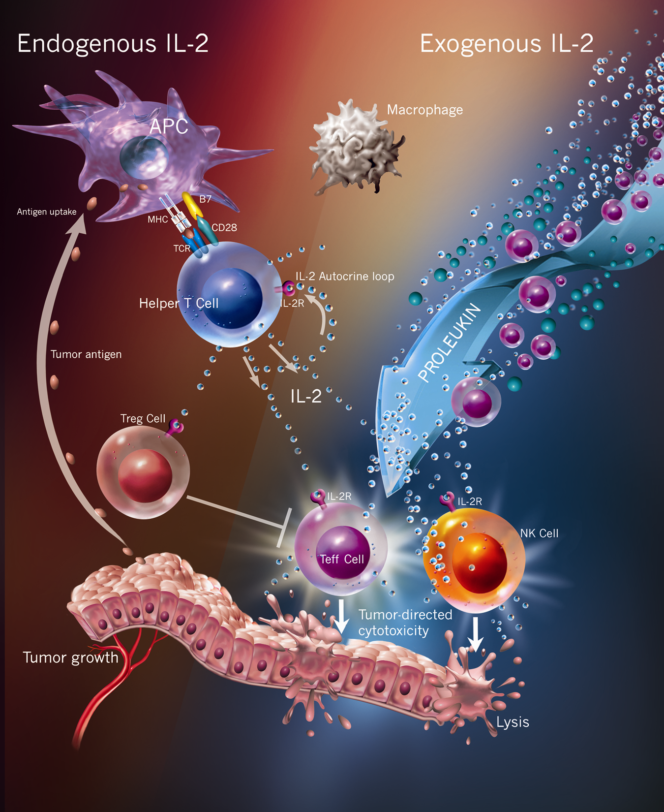
Interleukin-2: Immunologic Background
Natural biologic immunomodulatory agent
Autocrine T-cell growth factor
  Produced exclusively by activated T cells
  Predominantly CD-4+ (T-helper) lymphocytes
Immunomodulatory actions:
  Proliferation and activation of T cells
  Immune response amplification
  Enhanced antibody production by B cells
  NK cell expansion and activation
Stimulates T-cell secretion
  Tumor necrosis factor (TNF)
  Other cytokines (ie, IL-4, interferon-gamma)
Stimulates proliferation and activation of:
  All T cells, including cytotoxic
  T lymphocytes (CTLs) but also Regulatory T cells (Tregs)
  Natural killer and Lymphokine-activated Killer (LAK) cells
Abbas AK and Lichtman AH. Cellular and Molecular Immunology. 2003

Slide 8
Schedule for HD-Interleukin-2 Therapy
High-dose IL-2 (HD IL-2) has the potential to induce durable complete responses in a
small number of patients
600,000 IU/kg (0.037 mg/kg) delivered by 15-min bolus i.v. infusion q8h for 14 doses
720,000 IU/kg delivered by 15-min bolus i. v. infusion q8h for 12 doses
Additional courses of treatment are given if there is some shrinkage following the last course.
Each treatment course should be separated by a rest period of at least 7 weeks from the date of hospital discharge.
Typical Interleukin-2 Treatment Schedule
Treatment Course
Recovery Period
Cycle 1:
IL-2
q8h
Cycle 2:
IL-2
q8h
ASSESMENT
NO TREATMENT
Resume Normal Activities
Days 1-5
Days 6-14
Days 15-19
About 4-7 Weeks
~Day 63
.
Proleukin PI

Slide 9
High-Dose IL-2 Therapy
ORR: 16% (43/270)
Durable responses
  Median: 8.9 mos
  Median DOR if CR achieved: not reached
1.0
CR (n = 17)
PR (n = 26)
CR + PR (n = 43)
0.8
Probability of Continuing Response
0.6
0.4
0.2
0
0
10
20
30
40
50
60
70
80
90
100
110
120
130
Duration of Response (Mos)
Atkins MB, et al. J Clin Oncol. 1999;17:2105-2116.
Notes:
9
CR, complete response; DOR, duration of response; IL, interleukin; PR, partial response; ORR, overall response rate.

Slide 10
Newer Immunotherapies for Advanced Melanoma:
Checkpoint Blockade

Slide 11
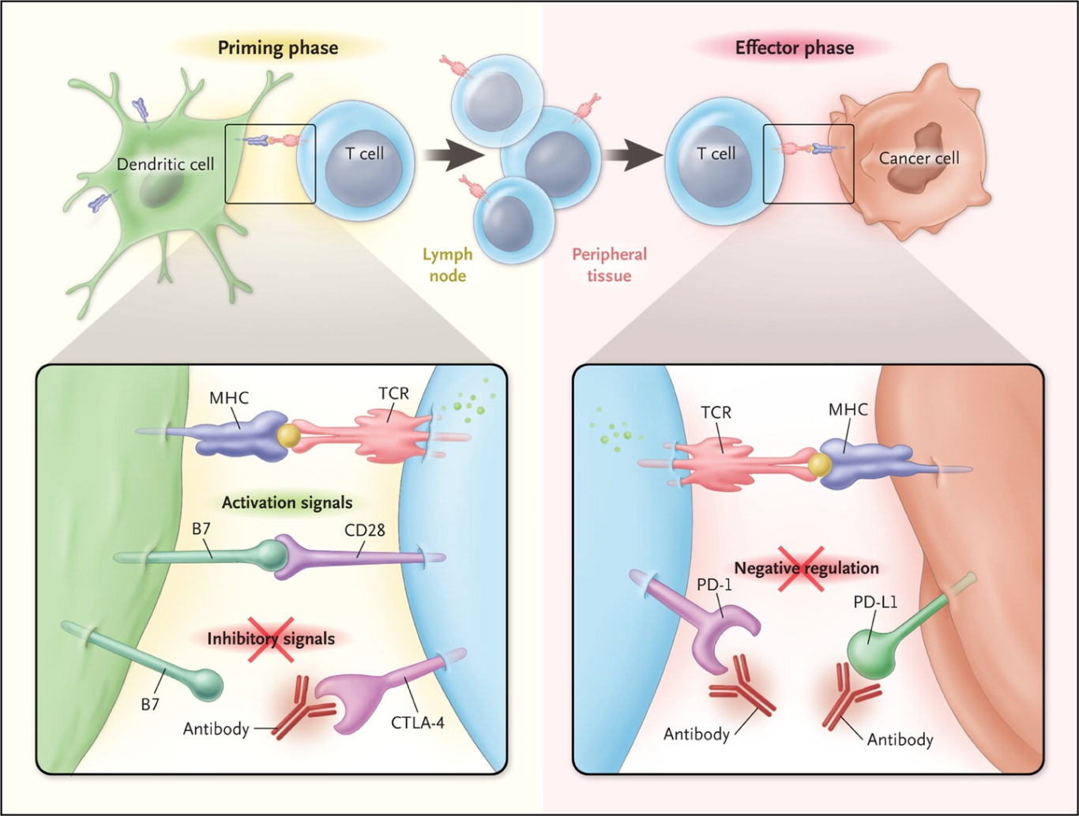
CTLA-4 and PD-1/L1 Checkpoint Blockade for Cancer Treatment
Ribas A. N Engl J Med. 2012;366:2517-2519. Copyright © 2012 Massachusetts Medical Society. Reprinted with permission from Massachusetts Medical Society.
Notes:
CTLA-4, cytotoxic T-lymphocyte antigen-4; PD-1, programmed death-1.

Slide 12

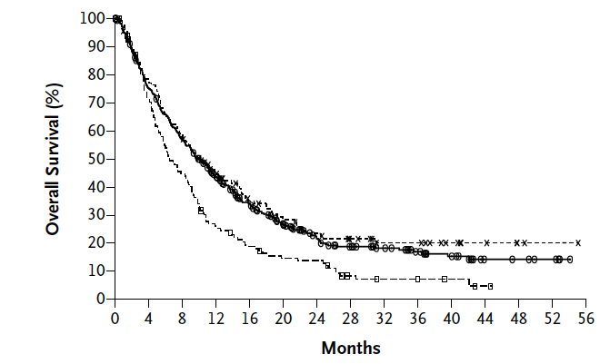
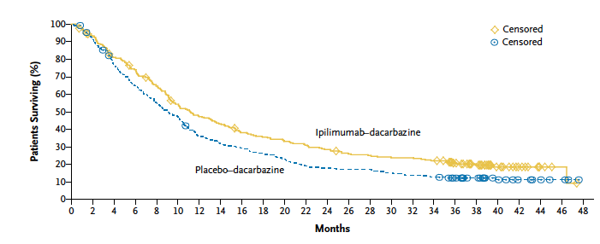
Improved Survival With Ipilimumab
Standard dose:3 mg/kg x 4 doses q3wks with or without gp100
10 mg/kg x 4 doses q3wks,
then q3mos + dacarbazine
Hodi et al, 2010; Robert et al, 2011.

Slide 13
Future Directions in Immunotherapy:
Anti PD-1/PD-L1 antibodies
New Combinations

Slide 14
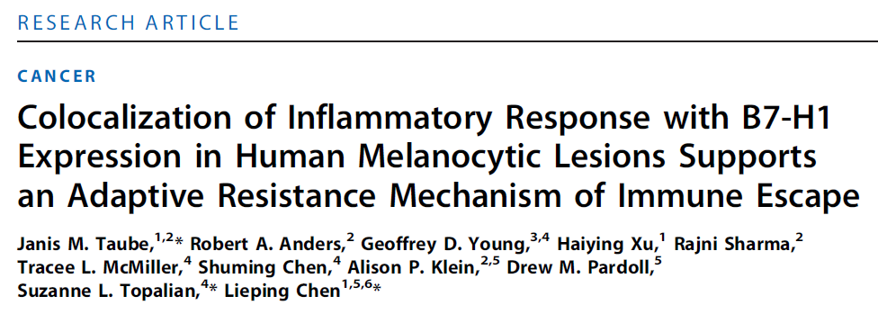
Induced Expression of PD-L1 (B7-H1) on Melanoma Cells by Infiltrating T Cells
Induction of the B7-H1/PD-1 pathway may represent an adaptive immune resistance mechanism exerted by tumor cells in response to endogenous antitumor activity and may explain how melanomas escape immune destruction despite endogenous antitumor immune responses
Taube et al, 2012.

Slide 15
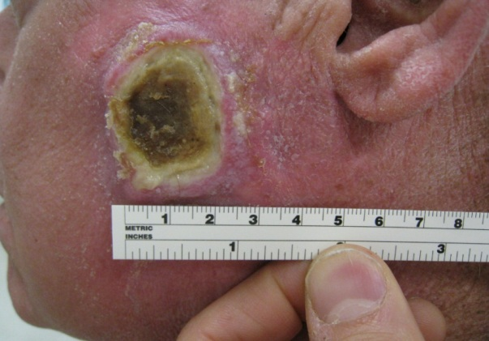
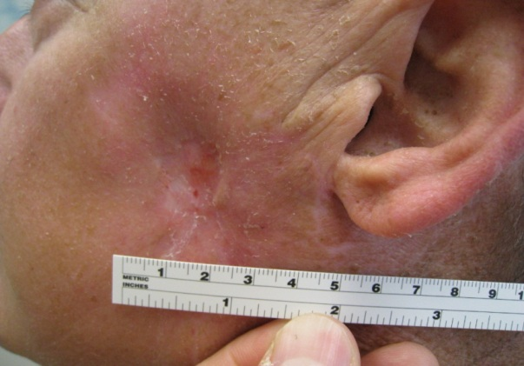
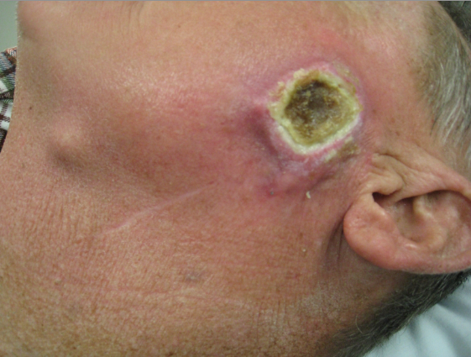
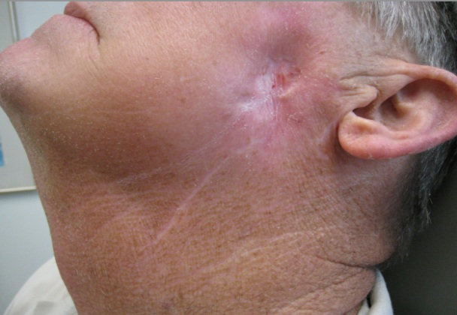
Clinical Activity of MK-3475 in a Patient With Metastatic Desmoplastic Melanoma
54-yr-old male with desmoplastic melanoma after progressing on ipilimumab
Baseline January 2012
April 2012
Hamid O, et al. N Engl J Med. 2013;369:134-144. Copyright © 2013 Massachusetts Medical Society. Reprinted with permission from Massachusetts Medical Society.

Slide 16
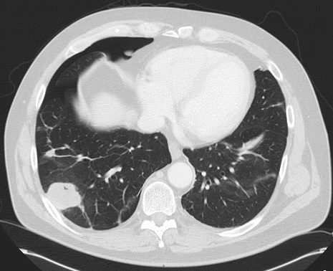
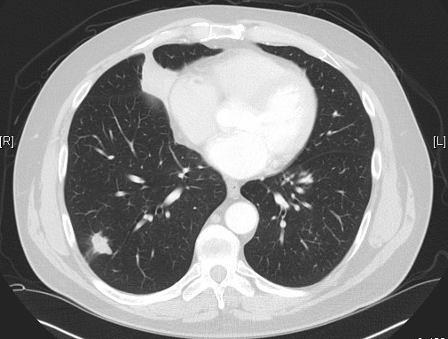
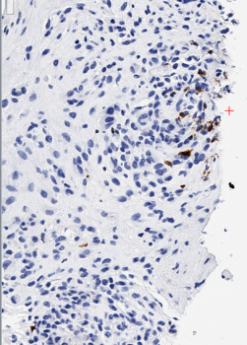
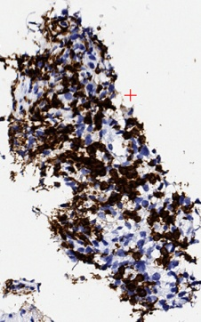
CTL Infiltrates in Regressing Metastatic Melanoma Lesion After MK-3475 Treatment
Baseline: February 29, 2012
August 20, 2012
CD8+ IHC
CD8+ IHC
Ribas A, et al. ASCO 2013. Abstract 9009.
Notes:
CTL, cytotoxic lymphocyte; IHC, immunohistochemistry.

Slide 17
Activity of Anti-PD-1/PD-L1 in Patients With Advanced Melanoma
Agent | Pts, n | ORR (at Optimal Dose), % | Grades 3/4 Tx-Related AEs, % | 6-Mo PFS, % | 12-Mo PFS, % | Median PFS, Mos | 1-Yr OS, % | 2-Yr OS, %
Nivolumab (anti-PD-1)^{[1-3]} | 104 | 31 (41) | 22 | 41 | 36 | 3.7 | 62 | 43
MK-3475 (anti-PD-1)^{[4,5]} | 135 | 38 (52) | 13 | NA | NA | > 7 | 81 | NA
BMS559 (anti-PD-L1)^{[6]} | 55 | 17 | 5 | NA | NA | NA | NA | NA
MPDL3280A (anti-PD-L1)^{[7]} | 44 | 29* | 36 | 43 | NA | NA | NA | NA
*Includes 4 patients with UM without a response.
1. Topalian SL, et al. J Clin Oncol. 2014;32:1020-1030. 2. Sznol M, et al. ASCO 2013. Abstract 9006.
3. Topalian SL, et al. N Engl J Med. 2012;366:2443-2454. 4. Ribas A, et al. ASCO 2013. Abstract 9009.
5. Hamid O, et al. N Engl J Med. 2013;369:134-144. 6. Brahmer JR, et al. N Eng J Med. 2012. 366:2455-2465. 7. Hamid O, et al. ASCO 2013. Abstract 9010.
Notes:
ORR, overall response rate; OS, overall survival; PD-1, programmed death-1; PD-L1, programmed death-ligand 1; PFS, progression-free survival; UM, uveal melanoma.

Slide 18
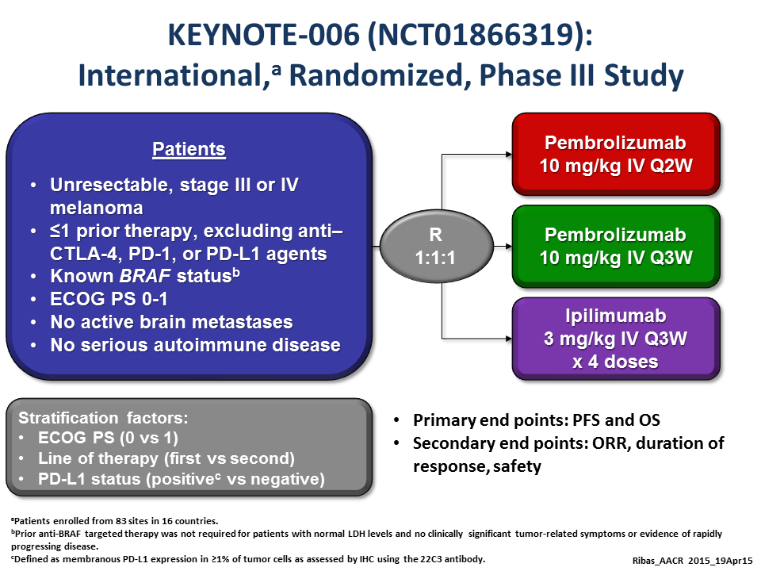

Slide 19
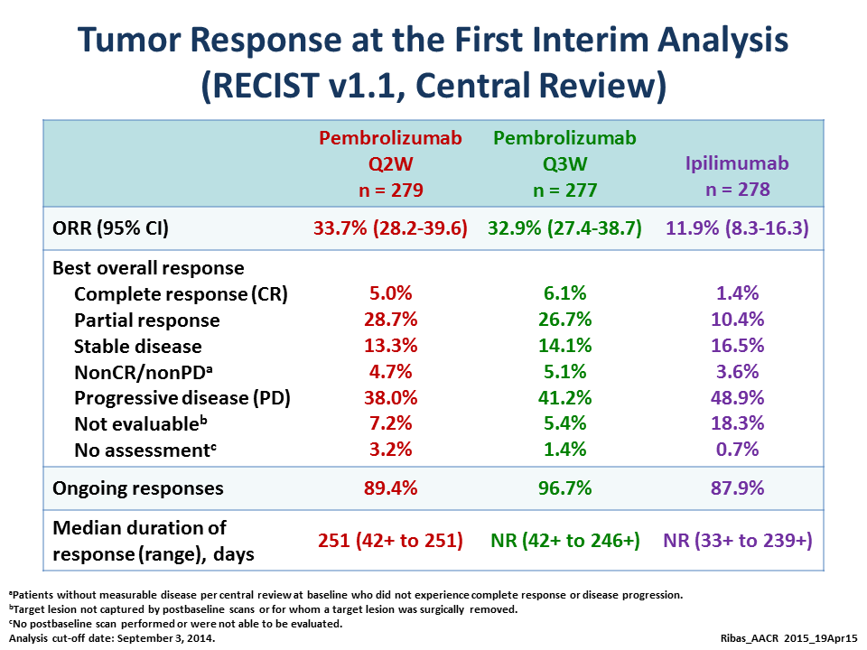

Slide 20
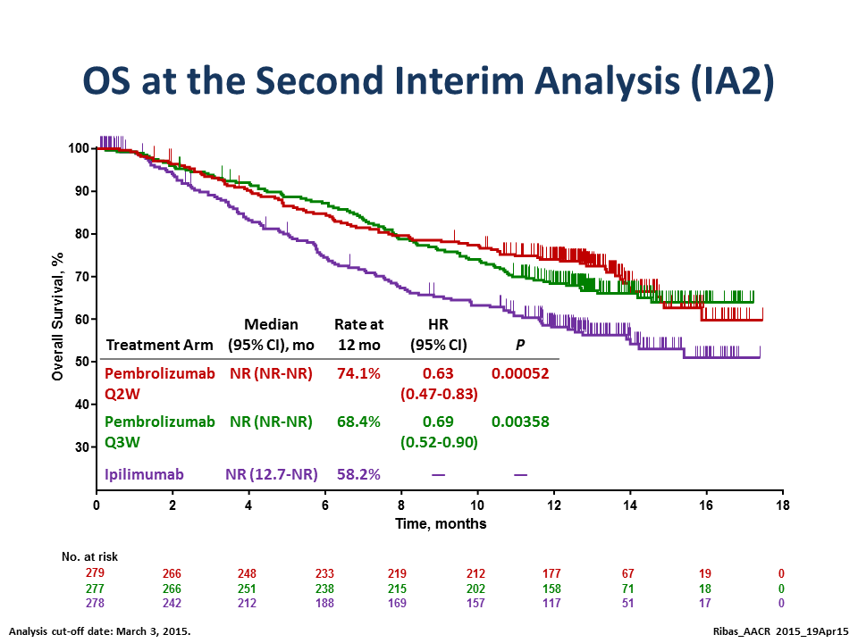

Slide 21
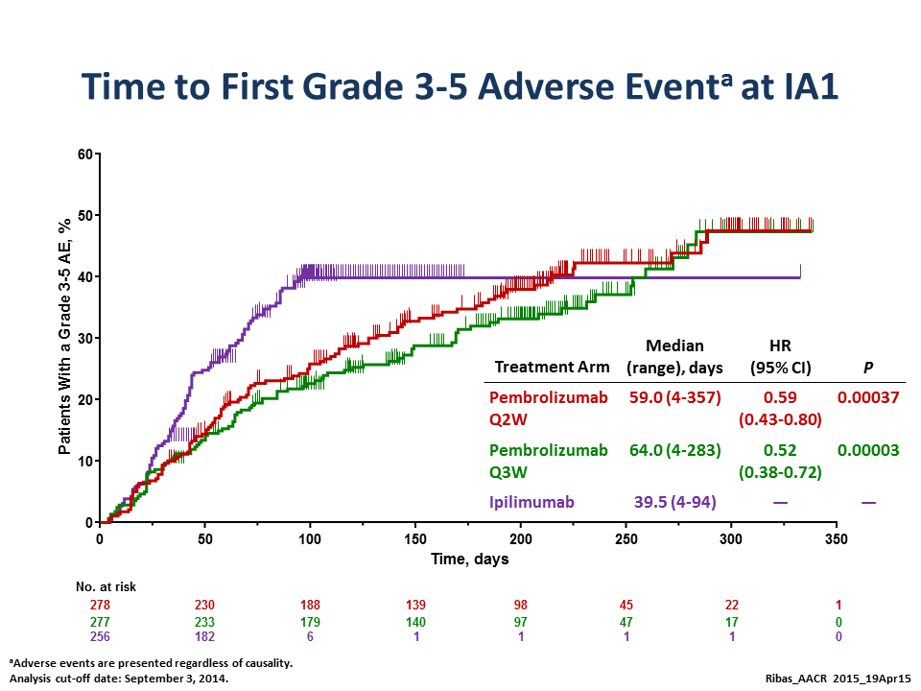

Slide 22
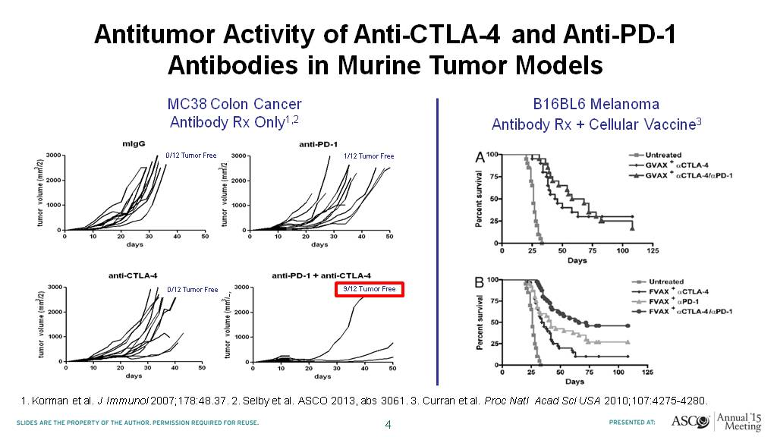
Slide 4
Presented By Jedd Wolchok at 2015 ASCO Annual Meeting

Slide 23
Phase II CA209-069: Study Design
Eligible patients with unresectable stage III or IV melanoma
Treatment-naïve
BRAF WT
(N = 100) or
MT (N = 50)
Stratified by BRAF status
NIVO
1 mg/kg
+
IPI
3 mg/kg
NIVO
3 mg/kg
Treat until:
disease progressionª
or unacceptable toxicity
Q3Wx4
Q2W
R
2:1
Double-blind
Placebo
+
IPI
3 mg/kg
Placebo
Q3Wx4
Q2W
ªTreatment beyond initial investigator-assessed RECIST v1.1- defined progression is permitted in patients experiencing clinical benefit and tolerating study therapy. IPI patients have an option to receive nivolumab monotherapy after progression. Upon confirmed progression and change of treatment, all patients are unblinded.
MT = mutation; PFS = progression-free survival; Q3W = every 3 weeks; WT = wild type
Primary endpoint:
  ORR in BRAF WT patients
Secondary endpoints:
  PFS in BRAF WT patients
  ORR and PFS in BRAF MT pts
  Safety
Notes:
In CheckMate 069, 142 patients with previously untreated unresectable stage 3 or 4 melanoma were randomly assigned 2:1 and in a double blinded manner to receive either nivolumab 1mg/kg plus ipilimumab at 3mg/kg concurrently every 3 weeks for 4 doses and then nivolumab alone at 3mg/kg every 2 weeks OR ipilimumab 3mg/kg +placebo. Randomization was stratified by BRAF mutant status. Treatment was continued as long as clinical benefit was observed or until toxicity. Patients who had investigator assessed disease progression could be treated beyond progression.
Because the primary endpoint of objective response rate was to be analyzed in BRAF wild type subjects, enrollment was stopped when 100 BRAF wild type patients had been randomized. Secondary endpoints included progression free survival, ORR and PFS in BRAF mutant patients and safety.

Slide 24
Time to and Durability of Response(All Randomized Responders)
 | NIVO + IPI (N = 95) | IPI (N = 47)
Median time to response, months (range)ª | 2.8 (2.3, 9.9) | 2.7 (2.5, 7.9)
Median duration of response, months (range)ª | NR (0‒12.1)^{b} | NR (3.5‒9.8)^{b}
Ongoing response among responders, n (%)ª | 46/56 (82) | 4/5 (80)
NIVO
+ IPI
On treatment
Off treatment
First response
Ongoing response
ªMinimum follow-up of 11 months from date of randomization
^{b}Censored data (response ongoing)
NR = not reached
68% of patients (30/44) who discontinued the NIVO + IPI combination due to drug-related toxicity experienced a complete
or partial response
IPI
0
8
16
24
32
40
48
56
64
72
Time (weeks)
Notes:
The median duration of response was not reached in either treatment arm with a minimum follow-up of 11 months. Ongoing responses at the time of the January 30 database lock was observed in 82% of combination treated patients who had developed a response and in the 4 out of 5 ipilimumab responders.
The swimmer plot also describes the time to response which are depicted with white dots - as can be seen on the graph- the median time to response was around 2.8 months in both groups, with the majority of all responses observed at the time of first scan.
Finally, the red bars on the swimmer depict when patients discontinued treatment for whatever reason. The majority of all discontinuations appeared to happen within the first 12 weeks of treatment. In this group of patients who discontinued due to toxicity, the objective response rate was 68% and the black arrows indicated that the majority of these patient still have ongoing responses.

Slide 25
ORR in Patient Subgroups
 | Events/Patients |  |  |  |  | Unweighted ORR difference (95% CI)
 | NIVO + IPI | IPI
Overall | 56/95 | 5/47 |  |  |  | 48% (33‒59)
M Stage at study entry
M1c | 26/44 | 5/21 |  |  |  | 35% (9‒54)
Age category
<65 years | 31/48 | 0/20 |  |  |  | 65% (43‒77)
≥65 years | 25/47 | 5/27 |  |  |  | 35% (12‒52)
PD-L1 statusª
≥5% expression | 14/24 | 2/11 |  |  |  | 40% (5‒62)
<5% expression | 31/56 | 1/27 |  |  |  | 52% (32‒64)
BRAF status
MT | 12/22 | 1/10 |  |  |  | 45% (8‒65)
WT | 44/73 | 4/37 |  |  |  | 50% (31‒62)
-10
0
10
20
30
40
50
60
70
80
90
100
ªAccording to a validated BMS/Dako assay
IPI
better
NIVO + IPI
better
Notes:
Subgroup analyses were conducted to assess the impact of M stage at study entry, age, PD-L1 status, and BRAF Status on efficacy. Numerically higher ORR differences as shown on the right of the screen- were observed across all subgroups when compared to the ipilimumab comparator.
In addition, high objective responses were observed in patients treated with the combination arm independent of PD-L1 expression status. For example, the patients with tumors showing at least 5% PD-L1 expression had a 58% ORR, whereas those whose tumors had a PD-L1 expression level less than 5%, the ORR was almost identical at 55%. Similar to earlier reports in the phase 1 004 study, BRAF mutant status also did not impact on response, with BRAF mutant patients and BRAF wild-type patients having similar high objective response rates of 55% and 60% respectively.

Slide 26
PFS in All Randomized Patients
 | NIVO + IPI (N=95) | IPI (N=47)
Death or disease progression, n/N | 42/95 | 32/47
Median PFS, months (95% CI) | NR | 3.0 (2.8‒5.1)
HR (95% CI), p-value | 0.39 (0.25‒0.63), p<0.0001
1.0
0.9
0.8
0.7
0.6
Proportion Alive and Progression-free
0.5
0.4
0.3
0.2
NIVO + IPI
IPI
0.1
0.0
0
3
6
9
12
15
18
Number of Patients at Risk
PFS per Investigator (months)
NIVO + IPI
95
69
58
47
26
1
0
IPI
47
22
10
7
2
0
0
Notes:
In the secondary endpoint of progression free survival, the nivolumab plus ipilimumab combination also demonstrated superior benefit when compared to ipi alone. In the all randomized patient population, median progression free-survival for the combination was not reached with a minimum follow-up of 11 months versus 3.0 months for the ipi arm. The reduction in the risk of progression or death was 61% for the combination group when compared with the ipilimumab control group.

Slide 27
Time to Onset of Grade 3/4 Treatment-related Select AEs
2.2 (0.1‒3.1)
NIVO + IPI
IPI
Skin (n = 8)
6.9 (0.9‒23.0)
Gastrointestinal (n = 18)
Gastrointestinal (n = 5)
5.7 (4.1‒11.3)
9.4 (6.7‒19.0)
Endocrine (n = 5)
Endocrine (n = 2)
8.0 (7.7‒8.3)
Hepatic (n = 12)
12.1 (3.1‒26.6)
14.6 (9.4‒19.9)
Pulmonary (n = 2)
29.0 (29.0‒29.0)
Renal (n = 1)
0
5
10
15
20
25
30
Weeks
Most grade 3/4 treatment-related select AEs occurred during the combination phase
Circles represent median; bars signify ranges
Notes:
This slide depicts when treatment related grade 3-4 select adverse events were most likely to appear in both treatment arms. As you will recall the nivolumab and ipilimumab combination phase comprised of 4 X 3 weekly infusions, before patients stop ipilimumab and continue with nivolumab monotherapy every two weeks. The majority of grade 3-4 select adverse events appear to occur during the first 12-14 weeks of treatment, with skin typically appearing in the first two weeks, followed by GI select adverse events and endocrine at around 9 weeks.

Slide 28
Is PD-L1 a valid Biomarker
Assays are technically difficult and imperfect
-No standard assay/each manufacturer has a proprietary antibody
-Variable targets for “positive” (tumor vs immune cells)
-Optimal specimen-paraffin embedded archive vs fresh vs met or primary
In most studies, most responders are PDL-1 negative
Threshold for declaring “positive” different in various studies (Nivo 067-27% PDL1+ vs Keynote 006 study-80% PDL-1+)
And yet?????????

Slide 29
PD-L1, PD-1, and TIL are associated with response with response to anti-PD-1 therapy
Tumor biopsies performed before and during pembrolizumab
Performed quantitative IHC, quantitative multiplex immunofluorescence, and next generation sequencing for T-cell antigen receptors.
Tumeh PC, et al., Nature Letter 2015

Slide 30
PD-1/PD-L1 interface and TCR clonality predict for anti-PD-1 response
Tumeh PC, et al., Nature Letter 2015
Notes:
TCR clonality – performed high throughput quantitative sequencing of the rearranged TCR-beta genes using Immunoseq

Slide 31
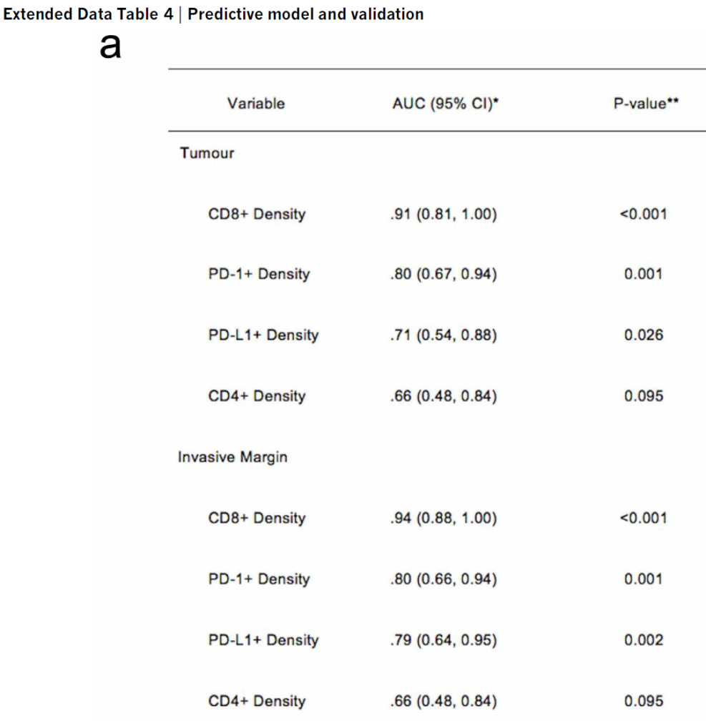
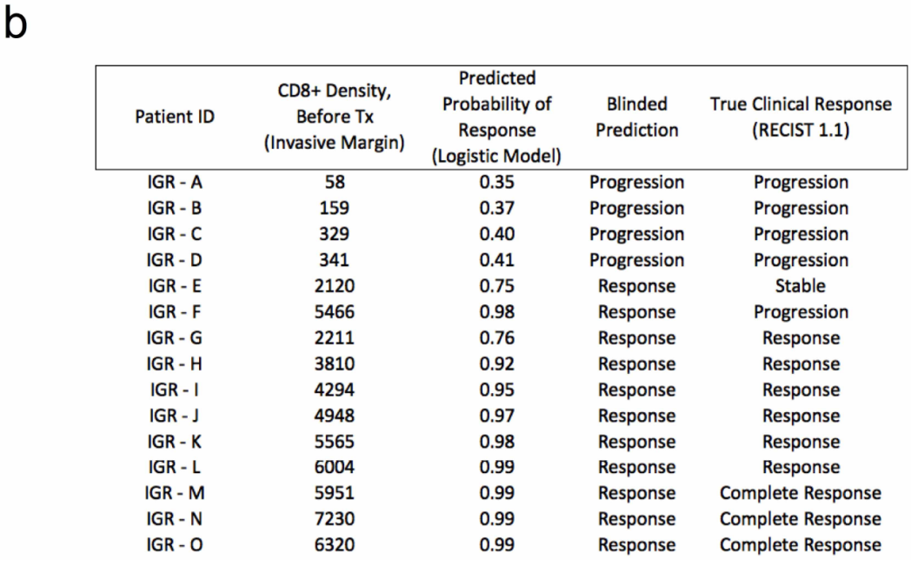
Predictive model validated in separate panel of tumor biopsies for anti-PD-1 response
Accurately predicted 4/5 patients with progression and 9/9 patients with response to anti-PD-1 therapy.

Slide 32
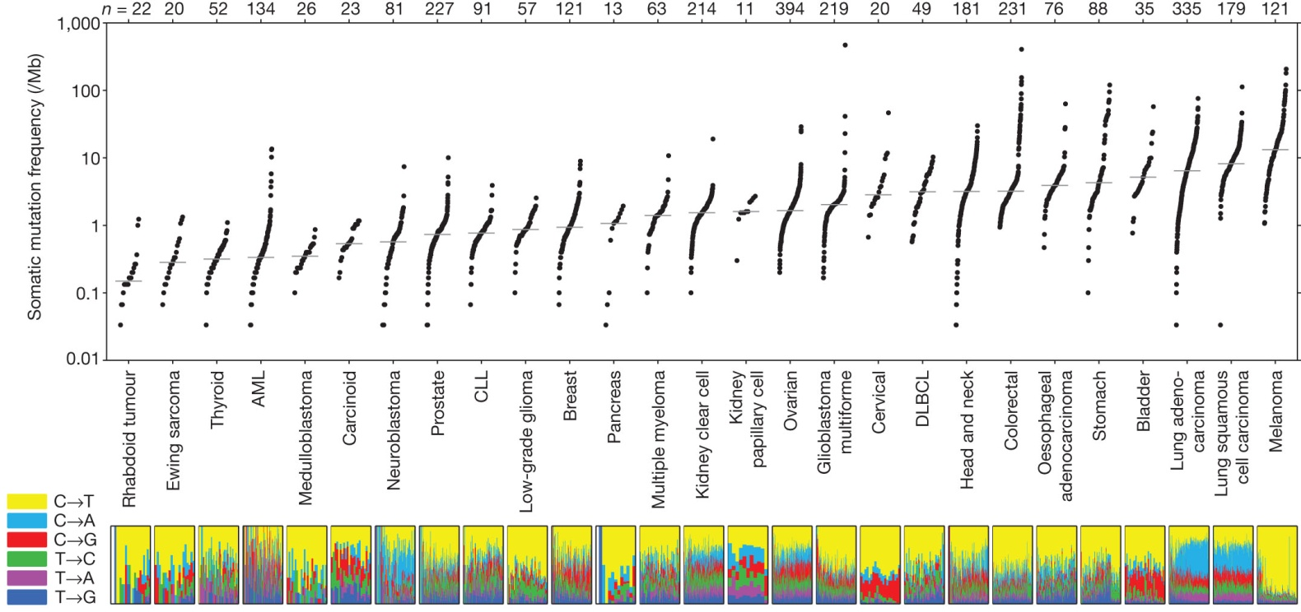

A Better Biomarker for Tumor Selection?
Somatic mutation frequencies observed in exomes from 3,083 tumor–normal pairs.
MS Lawrence et al. Nature 000, 1-5 (2013) doi:10.1038/nature12213

Slide 33
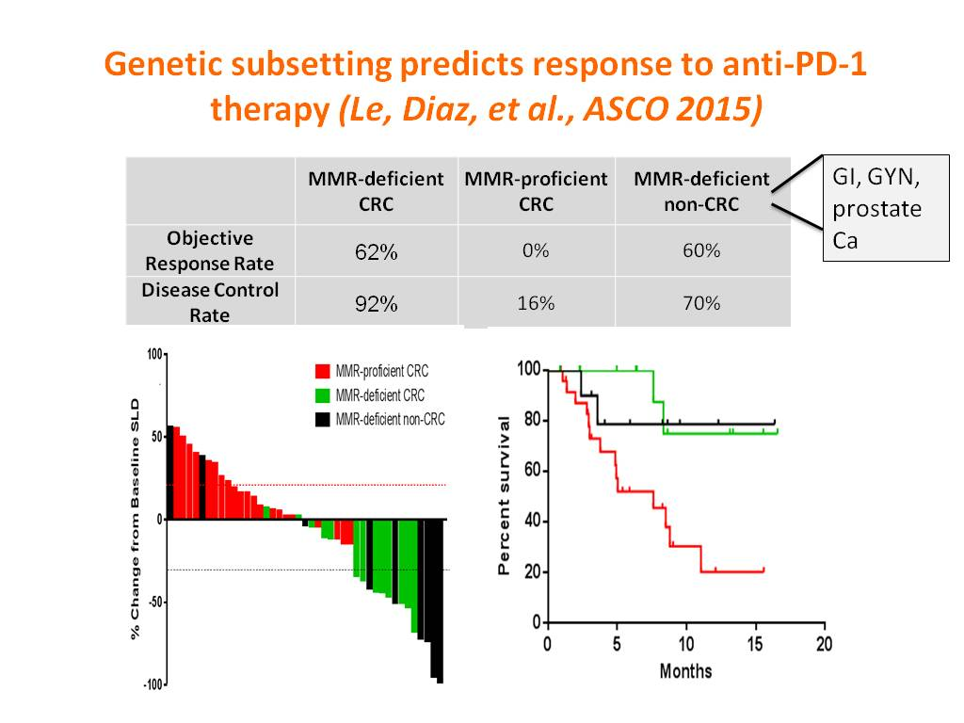
Genetic subsetting predicts response to anti-PD-1 therapy (Le, Diaz, et al., ASCO 2015)

Slide 34
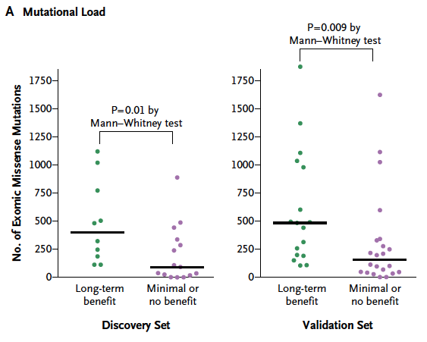
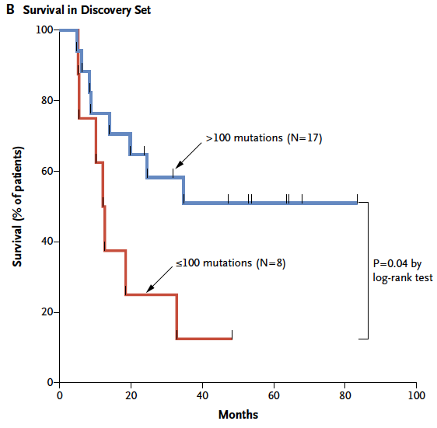
Association of Mutational Load with Clinical Benefit of anti-CTLA therapy in Melanoma Patients
Snyder A, N Engl J Med, 2014
Notes:
HiSeq 2000 platform (Illumina) provided more than 100x coverage for exome sequencing

Slide 35
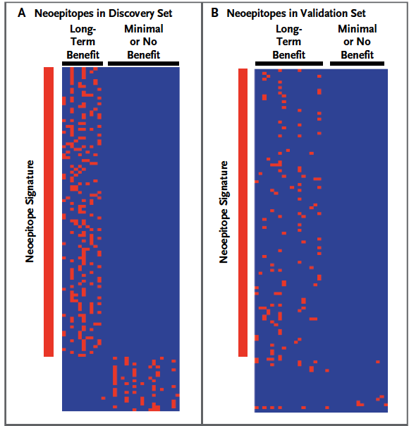
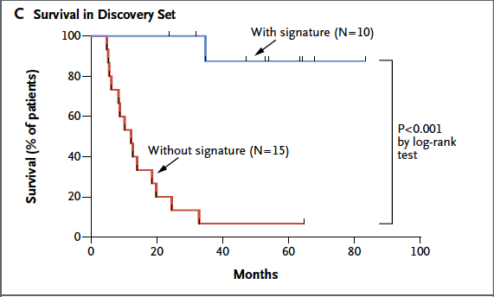
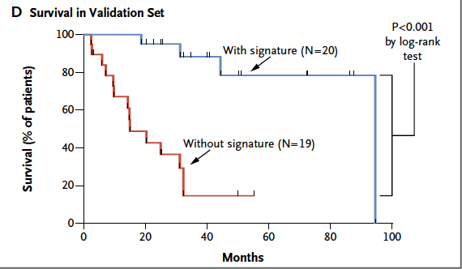
Association of Neoepitopes with Clinical Benefit of anti-CTLA4 therapy in Melanoma Patients
Snyder A, N Engl J Med, 2014
Notes:
Created a bioinformatic tool to translate all mutations in exomes and then evaluate the binding with major histocompatibility complex (MHC) class I molecules. This created a neoantigen signature. From nonamers containing four amino acid strings of peptides that are common to tumors with long-term benefit.

Slide 36
Nivo and Pembro and Nivo+Ipi all superior to Ipi.
These single agents (and possibly the combination should be standard first line therapy
Nivo +Ipi likely superior to Nivo alone (and Pembro?) but at a large financial and tolerability cost
Role for Biomarker of PD-L1 expression to help decide?
More trials needed
Conclusions

Slide 37
Audience Questions

