Slide 1
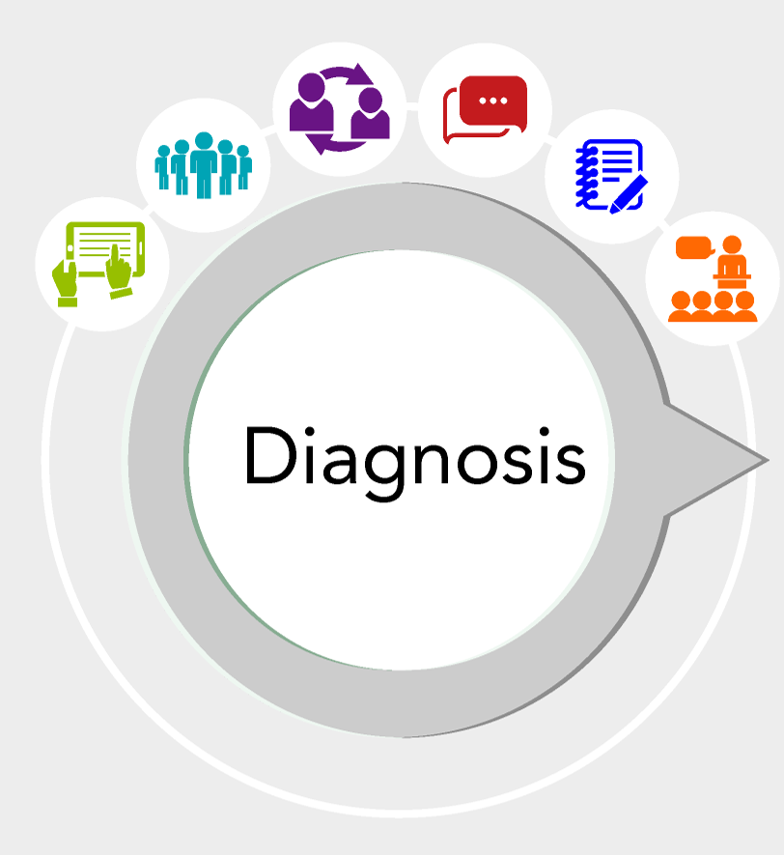
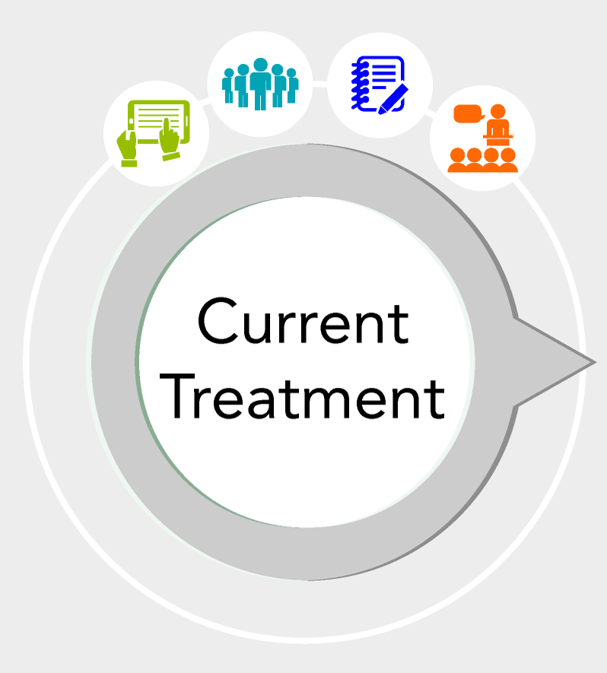
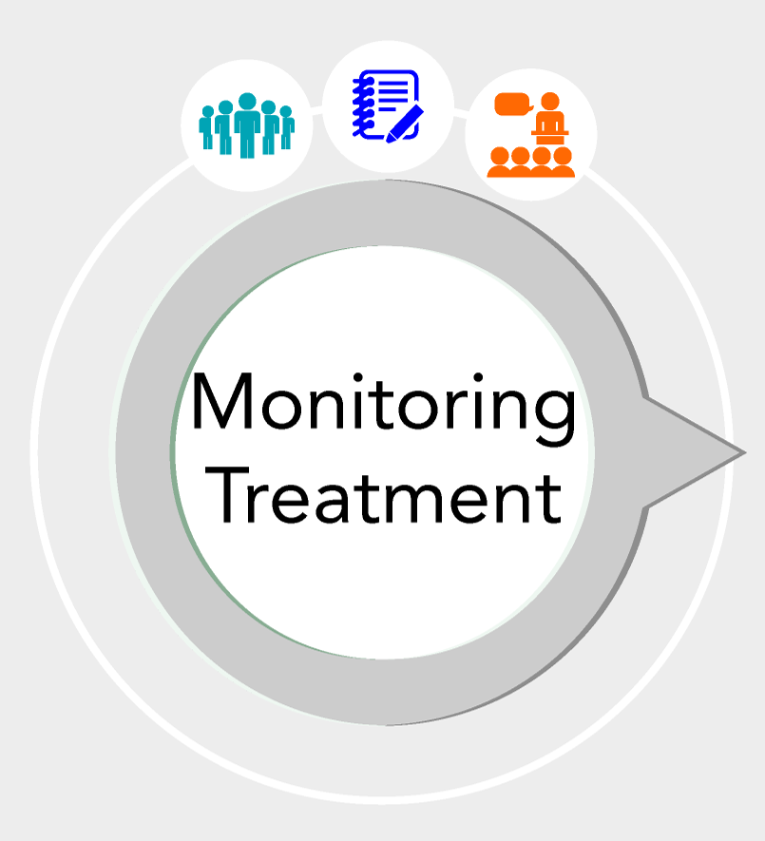
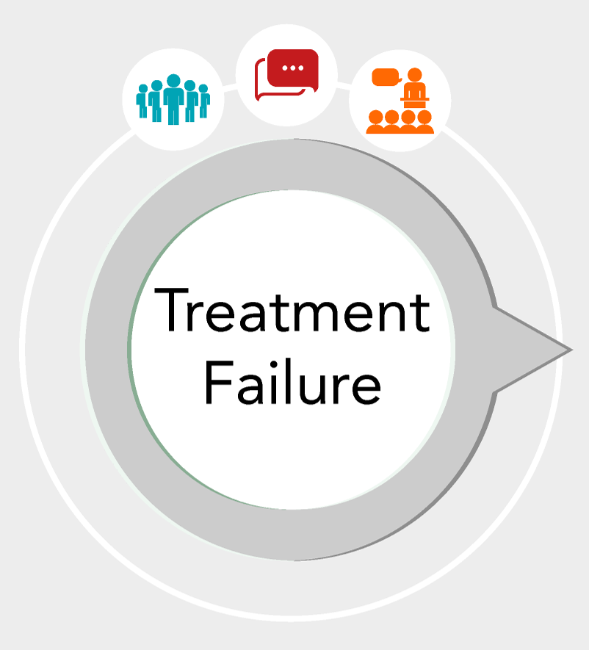
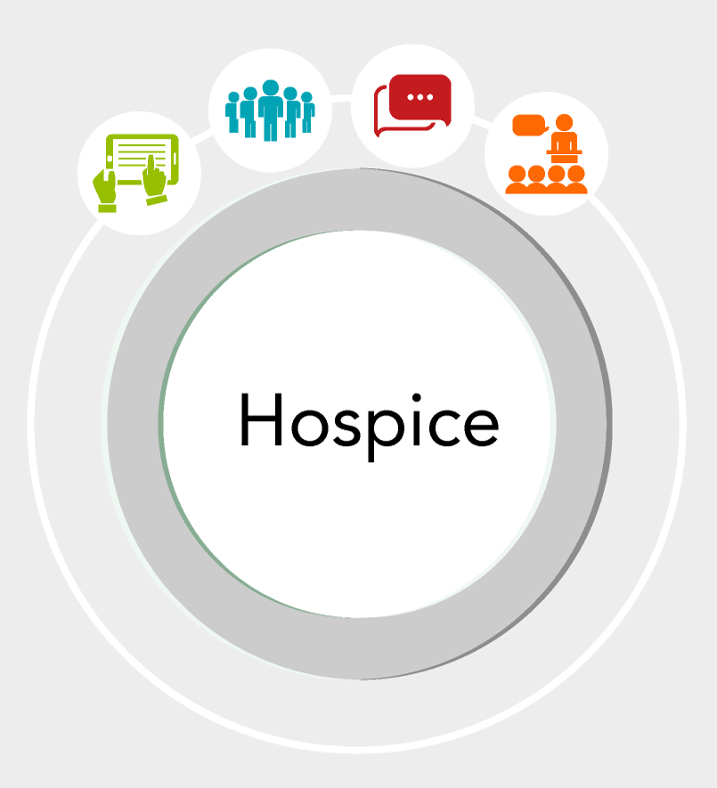
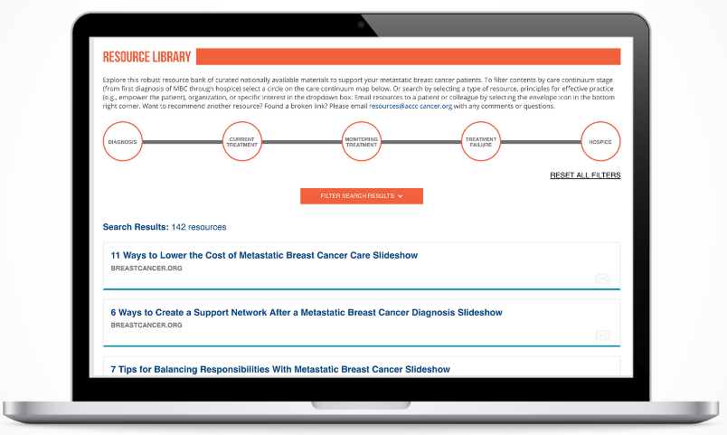
Metastatic breast cancer online resource library for 360 degree care from the Association of Community Cancer Centers Elana Plotkin, CMP-HC¹, Marianne Gandee, MA², Lorna Lucas , MSM¹ 1 Association of Community Cancer Centers, Provider Education, Rockville, MD, USA 2 Association of Community Cancer Centers, Development, Rockville, MD, USA Additional contribution by: Joanne Buzgalo, Phd, Cancer Support Community; Helen Chew, MD, UC Davis Cancer Center; Teresa Deshields, PhD, FAPOS, Siteman Cancer Center; William Gradishar, MD, FASCO, FACP, Robert H. Lurie Cancer Center; Julie R. Gralow, MD, Seattle Cancer Care Alliance; Amanda Holt, Maury Regional Medical Center; Shirley Mertz, Metastatic Breast Cancer Alliance; Ruth O’Regan, MD, Carbone Cancer Center; Hester Hill Schnipper, MSW, LICSW, OSW-C, Beth Israel Deaconess Hospital; Lillian Shockney, RN, MAS, Sidney Kimmel Cancer Center.
BACKGROUND
METASTATIC BREAST CANCER RESOURCES
An estimated 150,000 to 250,000 women in the U.S. are currently living with metastatic breast cancer¹. While breast cancer is a high-profile disease, receiving significant research funding and prevention initiatives, patients with metastatic breast cancer face unique challenges.
Public messaging about a “cure” is so pervasive that people diagnosed with metastatic breast cancer can be stigmatized by the perception that they’ve failed to take care of themselves.
OBJECTIVES AND METHODS
A process improvement workbook was created with a map of care from metastatic diagnosis through end of life. Relevant resources were attributed to five stages: Diagnosis, Current Treatment, Monitoring Treatment, Treatment Failure, Hospice.
To assist cancer centers in implementing these key principles throughout the patient journey without adding to workload, ACCC is directing teams to use a robust resource bank of validated tools and materials.
ACCC seeks to expand the current breast cancer conversation to address gaps between early and metastatic disease and improve the treatment and management of metastatic breast cancer in the community setting with publicly available supportive tools.
ACCC aims to address the communication challenges that cancer care teams face such as: Patient perception that their cancer is curable, patient level of engagement during conversations with providers, providers who may “minimize” the severity of the disease, and lack of awareness of available resources.
An environmental scan was completed of all available resources. An expert advisory panel was formed. 5 different community cancer centers completed in-depth focus groups on their care path. A survey on MBC Communication strategies was conducted.
Over 140 resources have been curated online to a filterable library that clinicians can use to provide free, nationally available resources to their MBC patients. Survey results indicate that 43% (n=86) of cancer programs do not use a different approach or resources for MBC patients in comparison to stage I-III.
The library may be filtered by selecting a type of resource, principles for effective practice (e.g., empower the patient), organization, or specific interest in the dropdown box. Resources can be emailed directly to a patient or colleague by selecting the envelope icon in the bottom right corner.
ACCC-CANCER.ORG/MBCRESOURCES
RESULTS: 6 EFFECTIVE PRINCIPLES
Principle #1: Empower the Patient
Principle #2: Reframe the Conversation
Principle #3: Reduce Patient Isolation
Principle #4: Offer Logistical Support at the Cancer Program
Principle #5: Connect Patients with Support in the Community
Principle #6: Collaborate in the Interest of Patients
These support principles can be applied throughout the continuum of care, from diagnosis through the end of life. This patient population should be given specialized care to address their unique diagnosis and improve communications with their care team. Each member of the multidisciplinary care team can apply these principles to their workflow. A self-assessment work page is included in this downloadable workbook, so that any team member can identify areas of opportunity to apply these principles to practice.
This patient population should be given specialized care to address their unique diagnosis and improve communications with their care team. The ACCC Resource Library gives both low and highly resourced programs access to more supportive care tailored to metastatic breast cancer.
Continue the conversation about improving care for metastatic breast cancer patients at www.accc-cancer.org/MetastaticBreastCancer, or contact Elana Plotkin, CMP-HC at eplotkin@accc-cancer.org.
PARTNER ORGANIZATIONS
1. Mariotto A, Etzioni R, Hurlbert M, et al. Estimation of the number of women living with metastatic breast cancer in the United States. Cancer Epidemiology Biomarkers Prev. Online May 18, 2017. In print June 1, 2017. DOI: 10.1158/1055-9965.EPI-16-0889.

